Slide 1

REVISION
Art & Literature
Module 5

Slide 2





Put the words in the box into the correct word web.
Which words can go in more than one word web?
jazz
rock
band
singer
concert hall
song writer
artist
pop
classic
performance
composer
concert
art gallery
sculptor
painter
sculpture
exhibition
audience
actor
jazz
rock
band
concert
singer
composer
concert hall
performance
song writer
classic
artist
pop
art gallery
performance
audience
sculptor
exhibition
actor
painter
artist
performance
sculpture

Slide 3
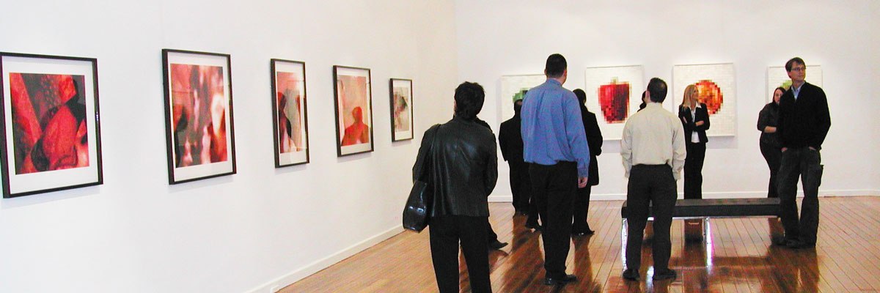
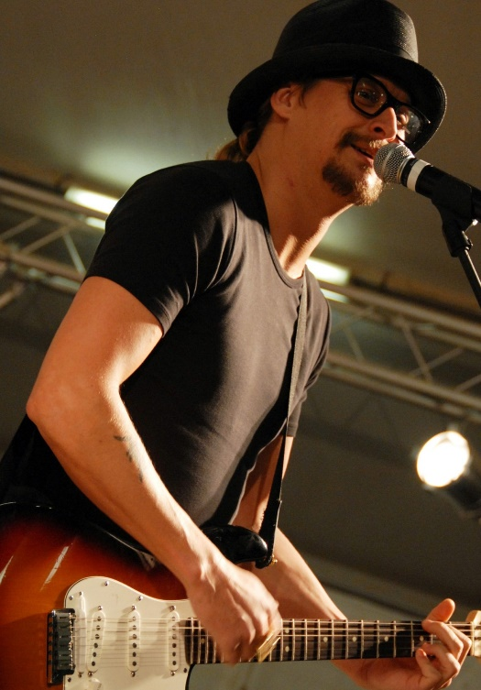
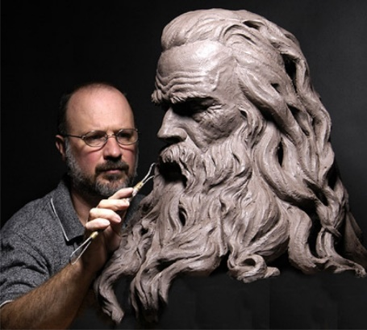
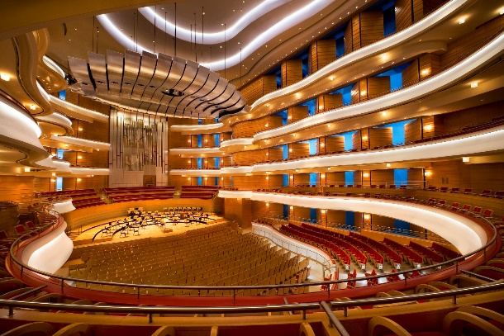
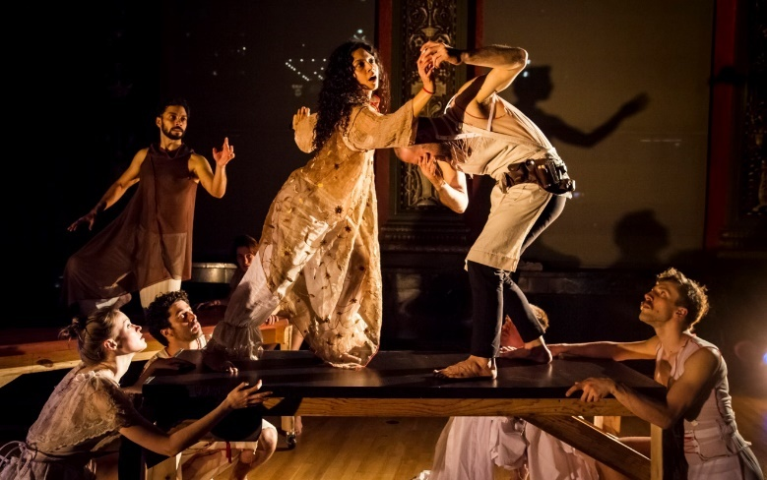
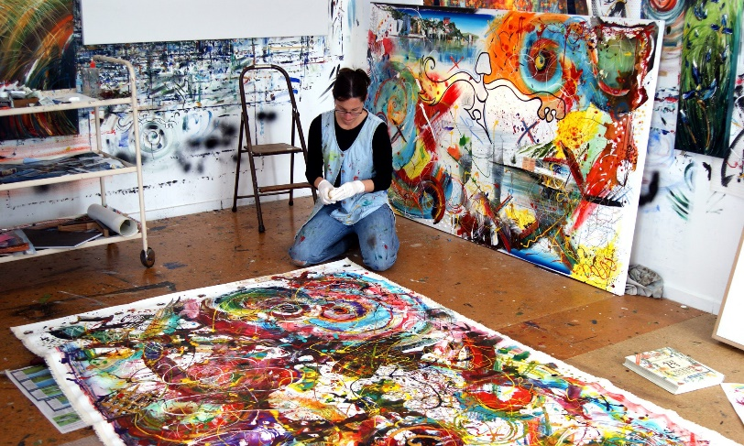
jazz
rock
band
singer
concert hall
song writer
artist
pop
classic
performance
composer
concert
art gallery
sculptor
painter
sculpture
exhibition
audience
actor
Look at these photos.
Which words from the box can you see in them?

Slide 4
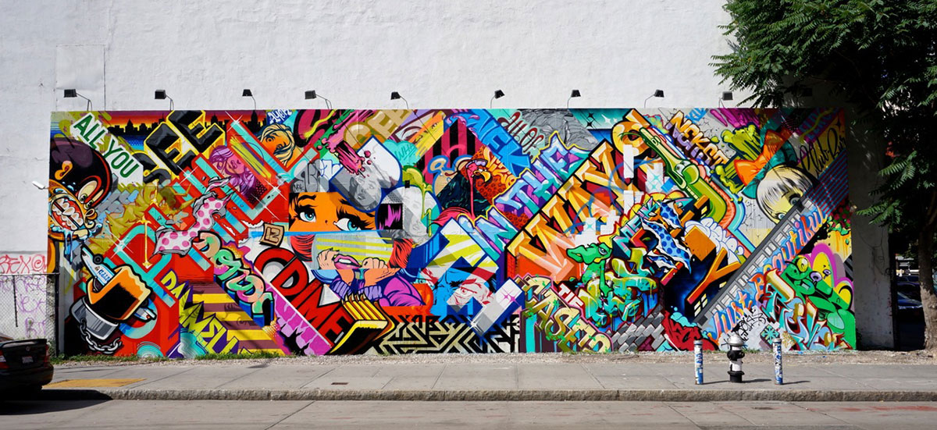
This can’t be art… or can it?

Slide 5
Explain the words in bold
miniature
the eye of a needle
tiny
significant
carving
hosted
impress
turn up
remain anonymous
vandalism
remove
take away
а very small copy of an object
command admiration
the hole in a needle
through which you put thread
presented
appear somewhere
extremely small
sculpting
act of damaging other people’s property
important, meaningful
the hole in a needle through which you put thread
sculpting
а very small copy of an object
presented
important, meaningful
command admiration
continue to be unknown
appear somewhere
extremely small
continue to be unknown
act of damaging other people’s property
take away

Slide 6
Fill in the missing word
miniature
1. ______________ sculptures
2. remain _______________
3. ____________ a look
4. ________________ difficulties
5. ________________ behaviourist
6. ______________________still
7. ________________ creativity
8. _______________ value to
9. _______________ property
10. ____________ of rice
grains
take
private
artistic
anonymous
miniature
animal
learning
add
stay perfectly
anonymous
take
learning
animal
stay perfectly
artistic
add
private
grains
Make up sentences based on the text:
Williard Wigan’s miniature sculptures are really amazing.

Slide 7
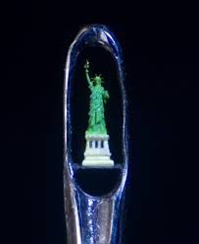
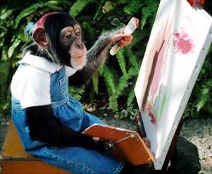
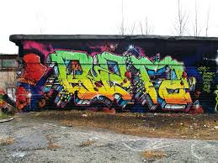
Find the opposites to the words
huge
unimportant
impatiently
excluded
inability
beautiful
responsible
public
worthless
tiny
significant
patiently
A
included
ability
B
ugly
irresponsible
private
valuable
C

Slide 8
Can you add any more types?
painting
живопись
drawing
рисование
carving
резьба
Types of art
pottery
гончарное дело
sculpture
скульптура
model making
моделирование
photography
фотография
spray painting
аэрография
Which do you like /
don’t you like? Why?
I like drawing because
it makes me feel relaxed.

Slide 9
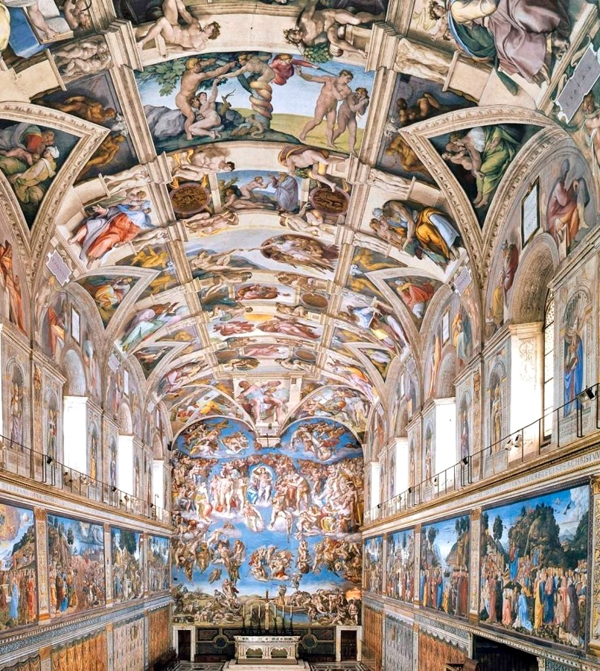
QUIZ
1
Which artist spent four years on his back painting the Sistine Chapel?
a) Salvador Dali
b) Michelangelo
b) Michelangelo
c) Leonardo da Vinci

Slide 10
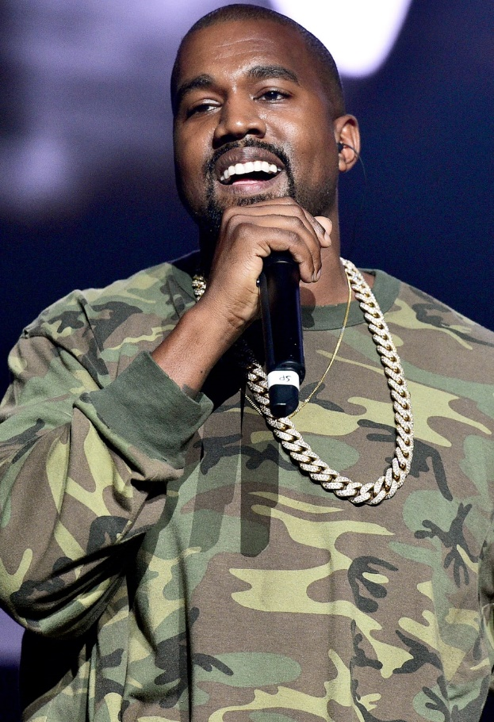
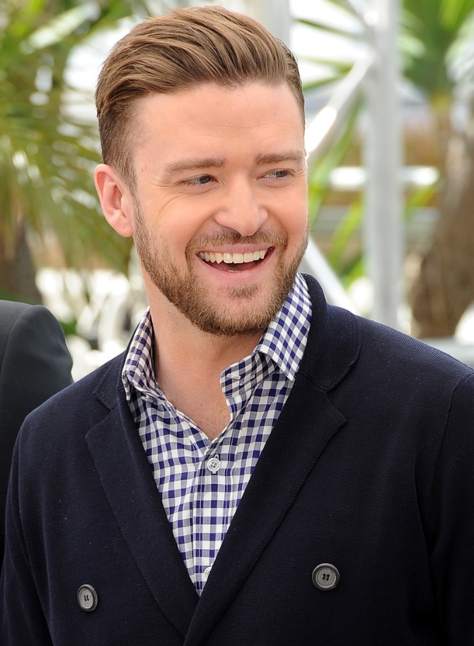
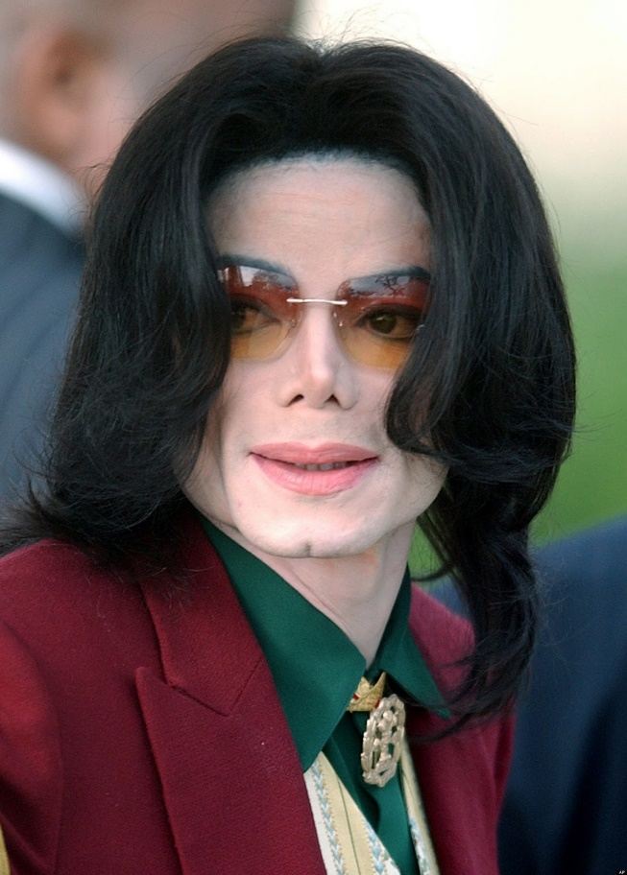
2
Who became famous as a five-year-old singer in a band of five brothers and later married Elvis Presley’s daughter?
a) Kanye West
b) Justin Timberlake
c) Michel Jackson
c) Michel Jackson

Slide 11
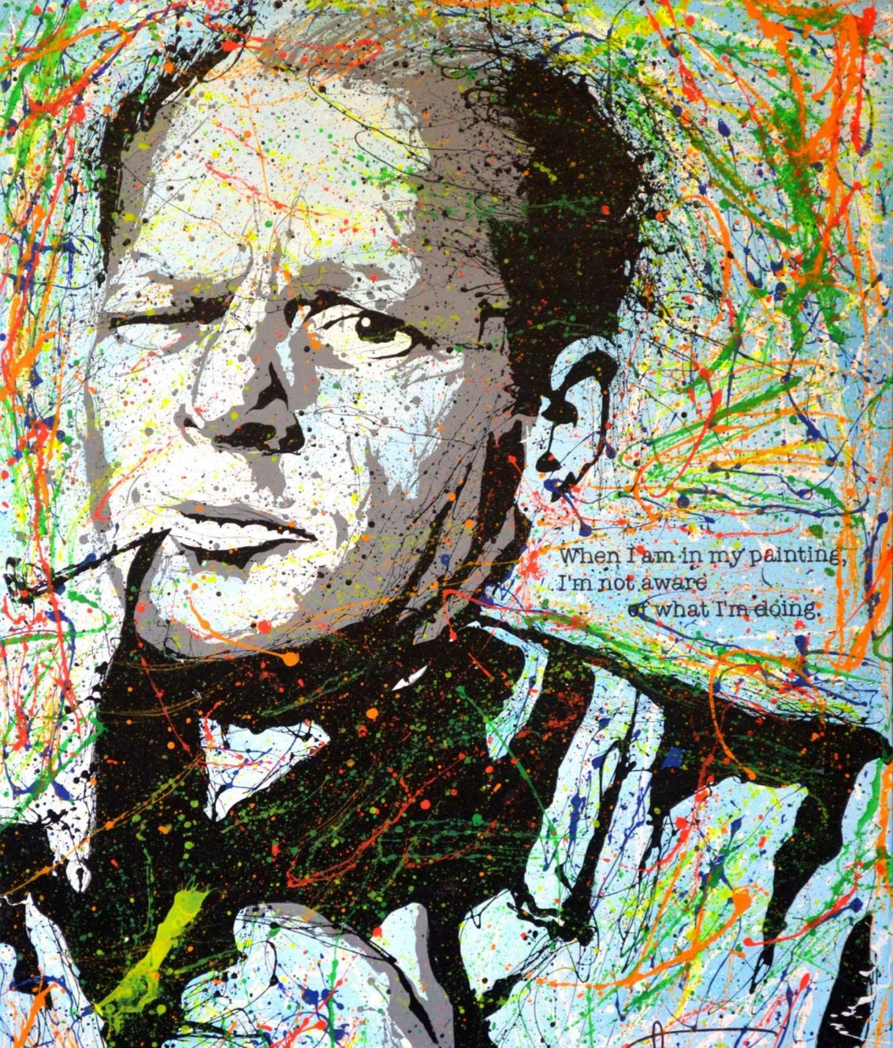
3
Who became famous for dropping and throwing paint to produce paintings?
a) Pablo Picasso
b) Edouard Manet
c) Jackson Pollock
c) Jackson Pollock

Slide 12
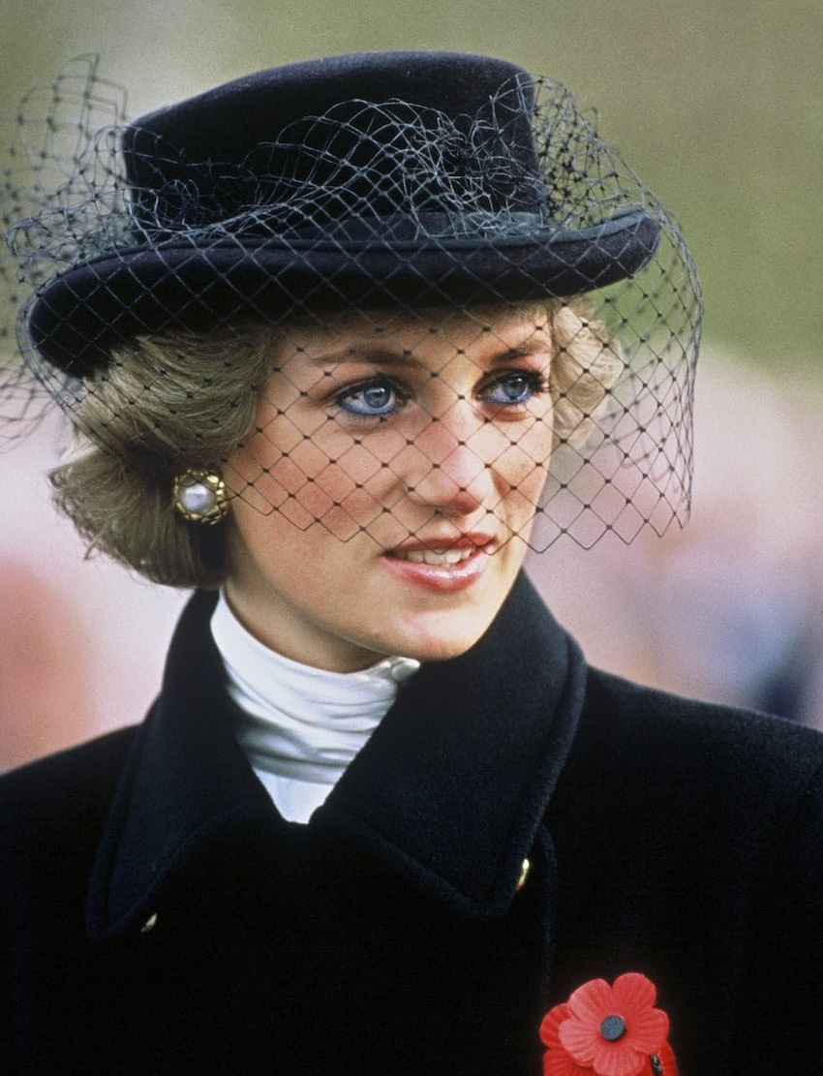
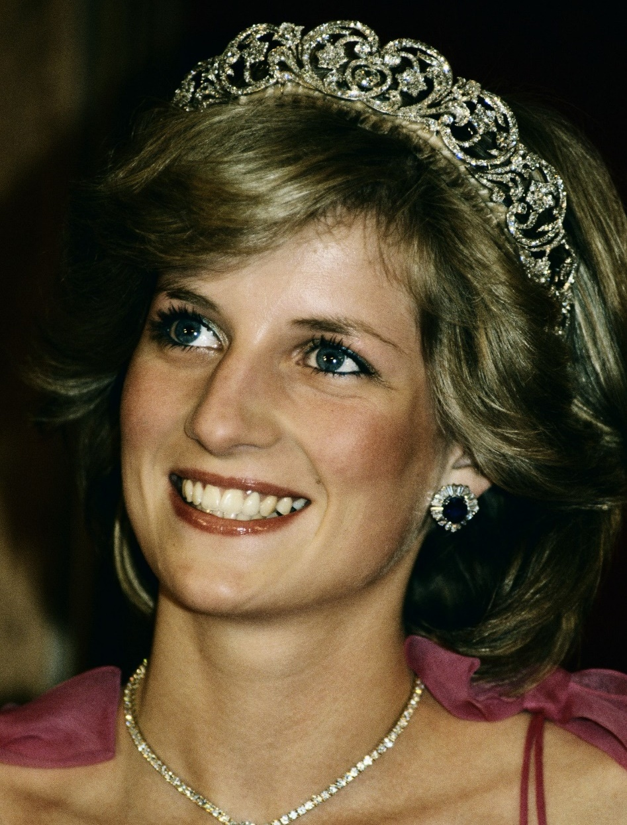
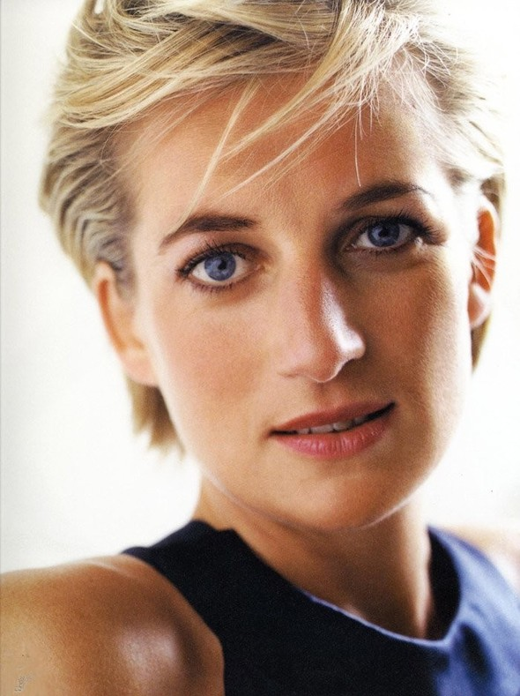
4
Which song about Marilyn Monroe has sold over 35 million copies, and was played by Elton John at Princess Diana’s funeral?
a) “Candle in the Wind”
a) “Candle in the Wind”
b) “Thriller”
c) “Your Song”

Slide 13
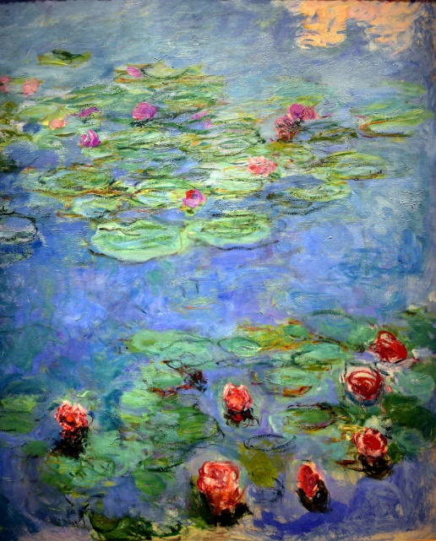
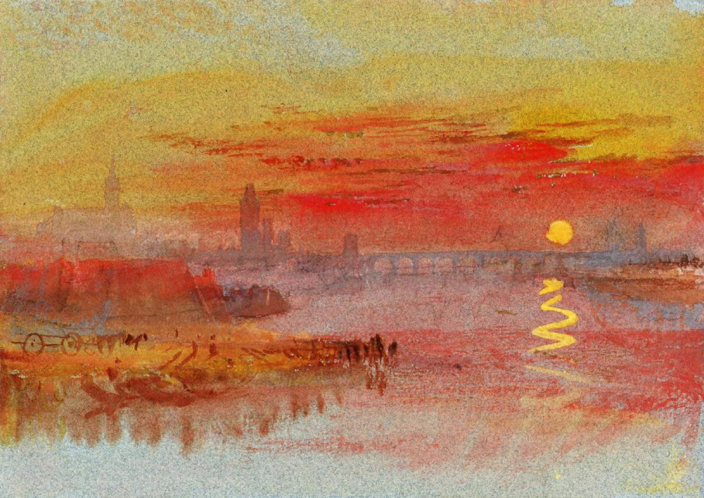

5
Which painting was upside down for two months in New York’s Museum of Modern Art before anyone noticed?
a) Water Lilies by Claude Monet
c) The Boat by Henri Matisse
b) Sunset on Rouen by J W Turner
c) The Boat by Henri Matisse

Slide 14
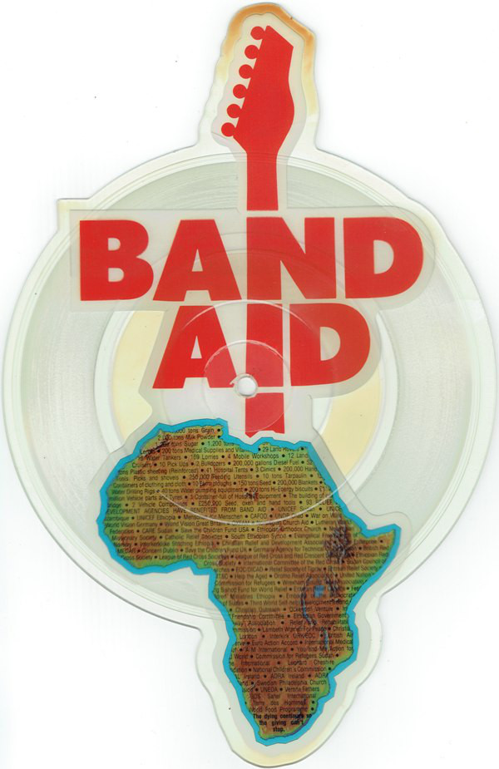
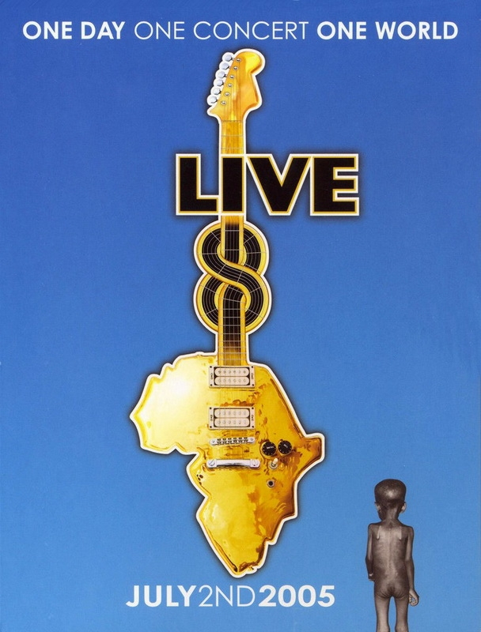
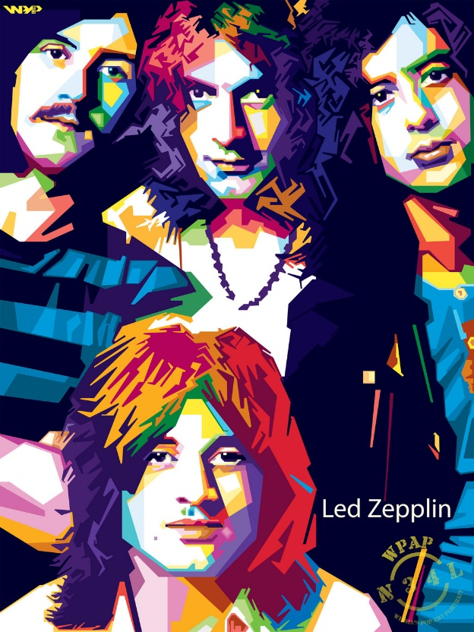
6
Which concert in 2005 took place in ten cities at the same time (including Rome, Berlin, Paris, London and Moscow) and had over 1,000,000 people in the audience?
Live 8 was a string of benefit concerts that took place on 2 July, 2005, in the G8 states and in South Africa.
They were timed to precede the G8 Conference and Summit held in Scotland.
The concerts were run in support of the aims of the UK's Make Poverty History campaign and the Global Call for Action Against Poverty.

Slide 15
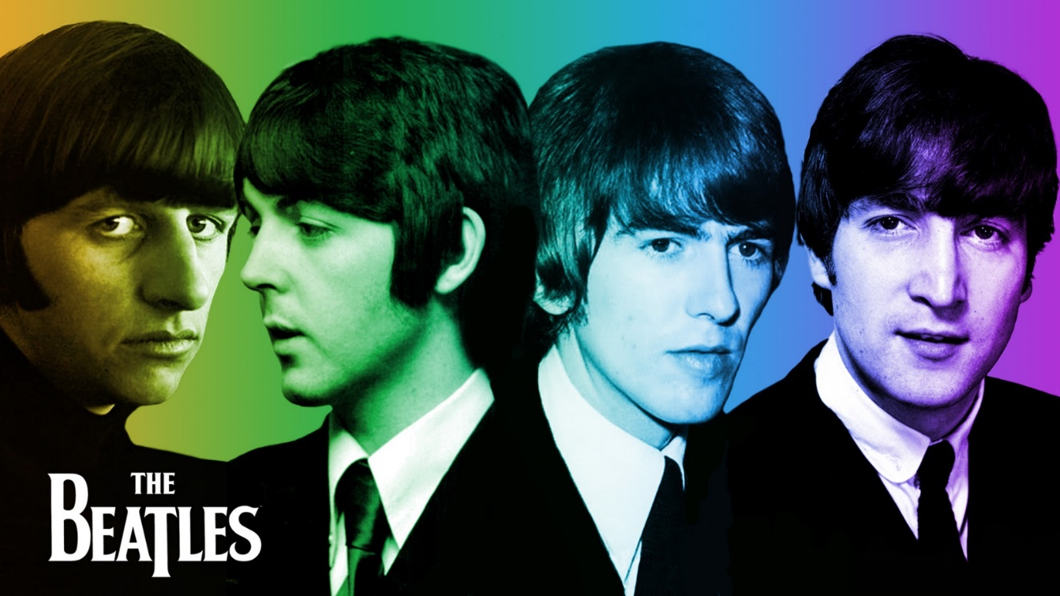
7
Which Beatles song title changed to become “Yesterday”?
a) “Tomorrow”
b) “Heavenly”
c) “Scrambled Eggs”
c) “Scrambled Eggs”
The working opening verse had these words.
Later it was replaced by “Yesterday”.

Slide 16
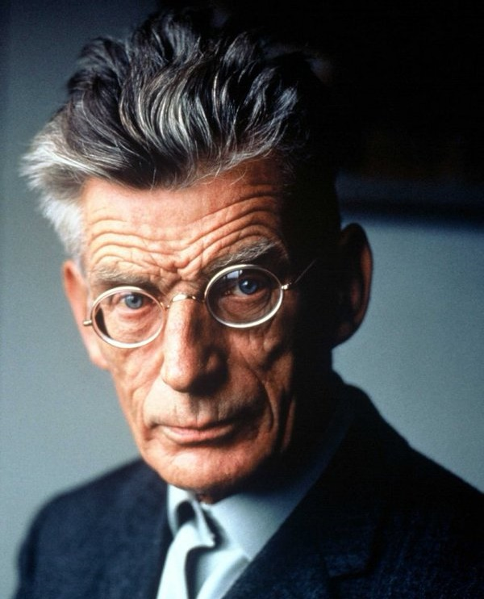

8
Whose play, called “Breath”, lasts just 35 seconds and consists of no words?
a) George Bernard Shaw’s
b) William Shakespeare’s
c) Samuel Beckett’s
c) Samuel Beckett’s

Slide 17
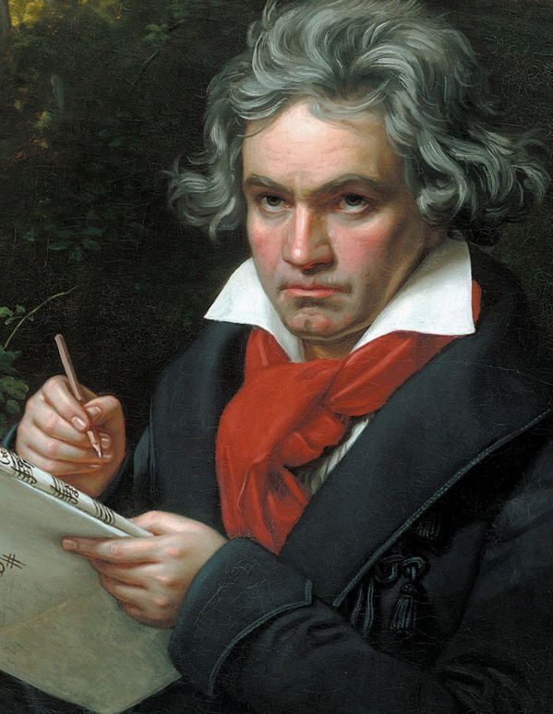
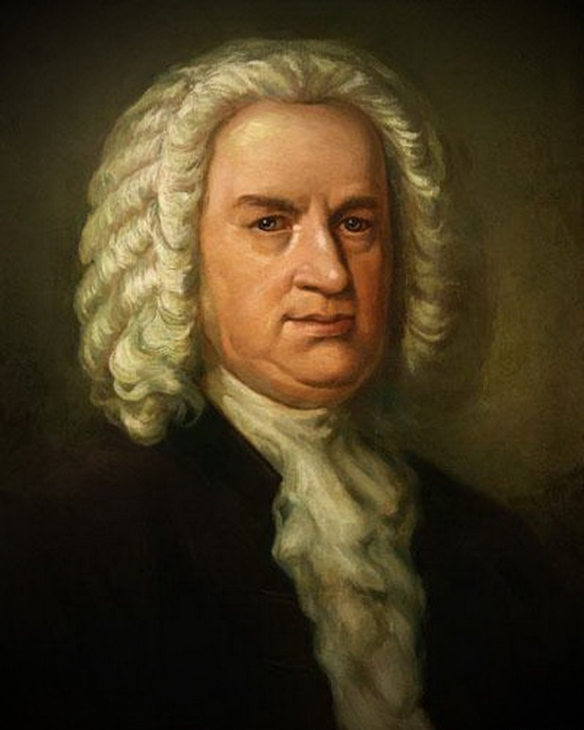
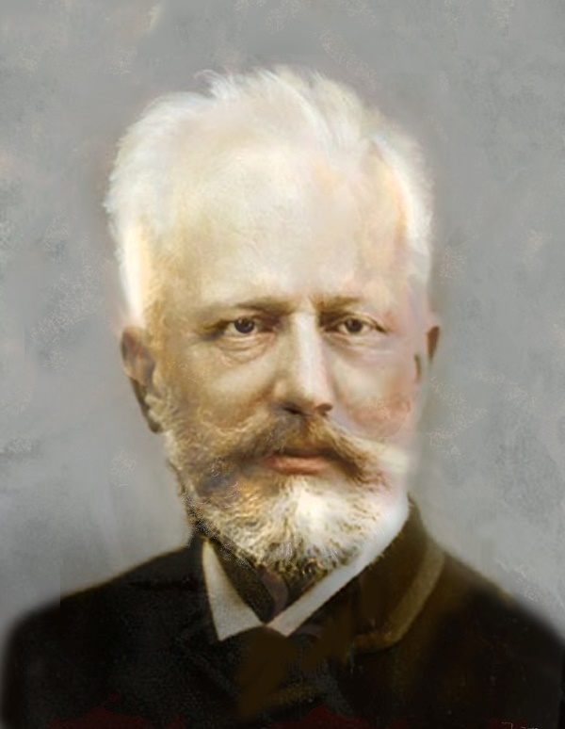
9
Which composer continued composing music after he became deaf?
a) Beethoven
a) Beethoven
b) Bach
c) Tchaikovsky

Slide 18
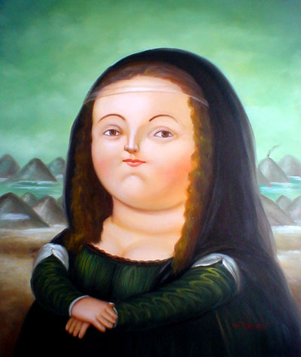
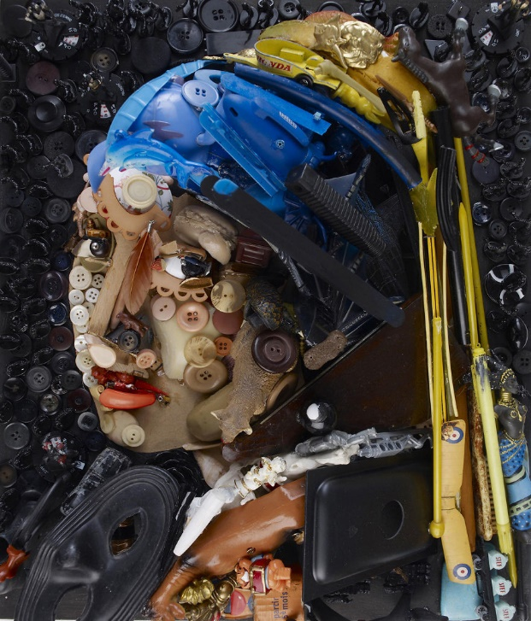
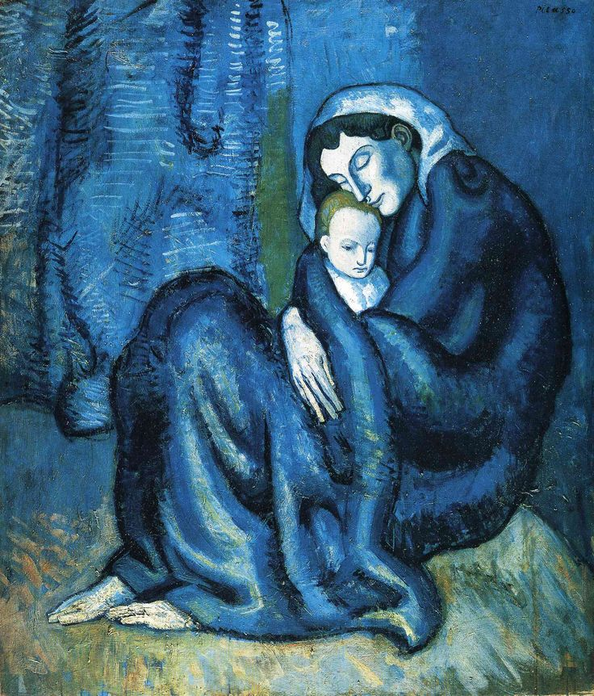
10
What is Fernando Botero’s art famous for?
for its fat people
b) he made his works of art of rubbish
c) he used only blue paint
for its fat people

Slide 19



