Slide 1
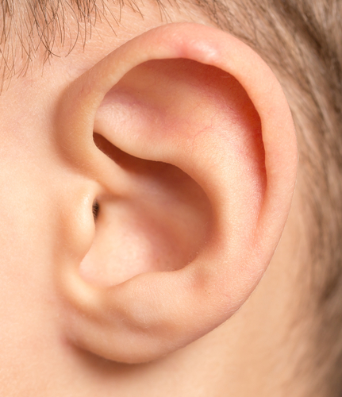
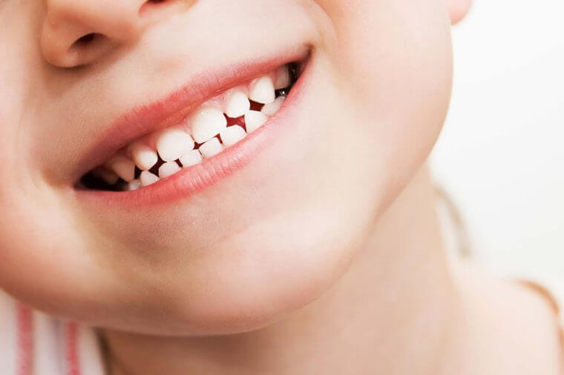
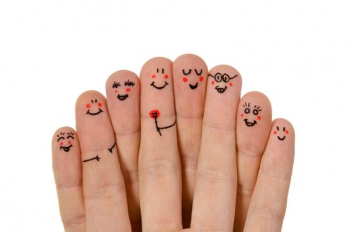

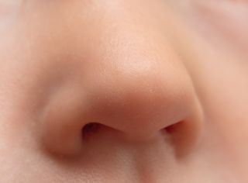
Which part(s) of the body do we need for the five senses below?
hearing
taste
touch
sight
smell

Slide 2
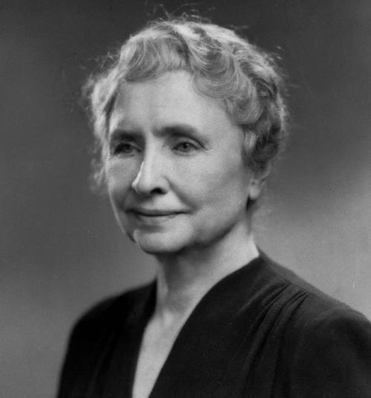

What do you know about Hellen Keller?
Why was her life
«an inspiration»?
Listen, read and check p.133
Helen Keller
(1880-1968)

Slide 3
1. What was so incredible about Hellen Keller?
2. What was Helen like when she was a young child? Why do you think she was like this?
3. How did Ann Sulivan influence Helen’s life?
4. What did Helen achieve when she was an adult?
5. What impresses you most about Helen Keller?
6. What can we learn from Helen’s life?
Helen Keller
(1880-1968)

Slide 4
Explain the words in bold in the text from the context
exist
to be real
blind
unable to see
deaf
unable to hear anything or unable to hear very well
tutor
teacher
strict
not allowing people to break the rules or misbehave
to progress
to improve and get better
ordinary
normal
to graduate
to get a degree from a university,
to complete a course at school
inspiration
an influence on people to achieve things

Slide 5
Reflection
What struck me today was …
I still have questions about …

Slide 6
Homework
Find information about a famous person from your country who inspires you and write a short biography of them.
You can include:
date/ place of birth
childhood
what famous for & why
achievements
date of death (if from the past) & your own ideas & attitudes

