Slide 1
Повторение по теме «Выбор профессии». Повторение по теме «Окружающий мир». Повторение по теме «Путешествия».

Slide 2
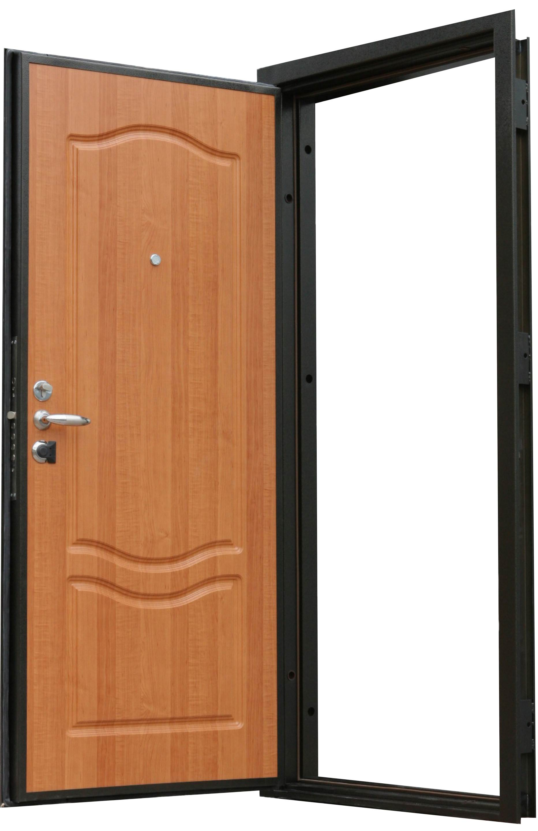
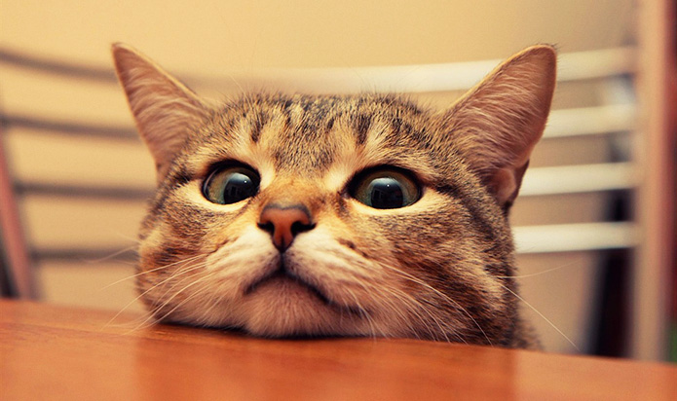
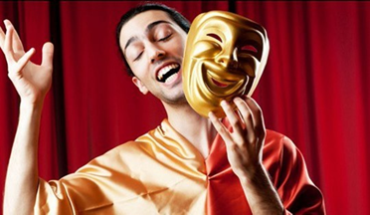
quiz
”
+
213
Actor

Slide 3
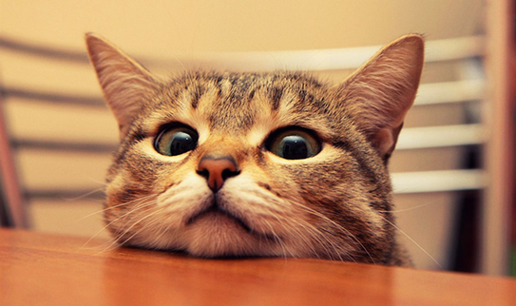
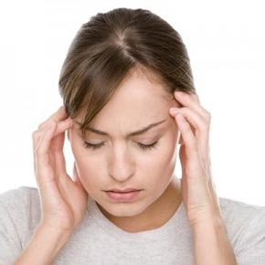
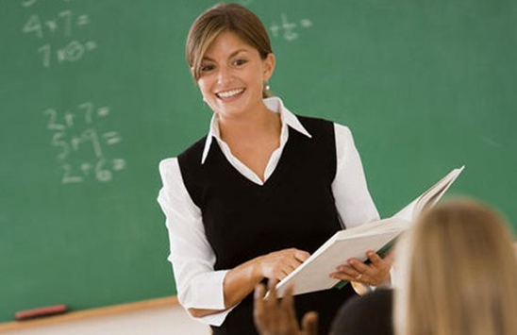
’
’
+
10
+
”’
21
”
+
4
Teacher

Slide 4
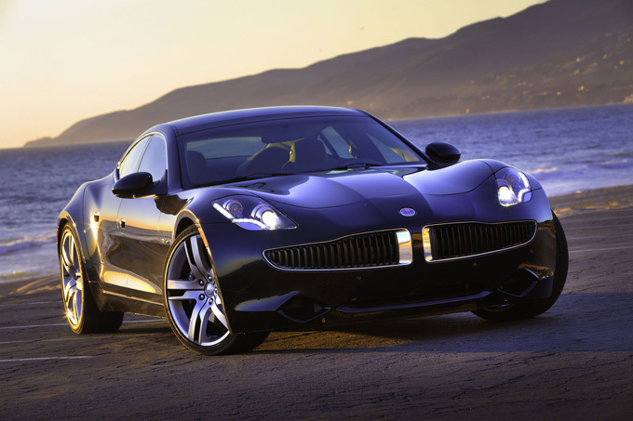
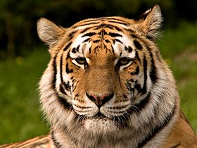



’
”’
”
+
+

Slide 5

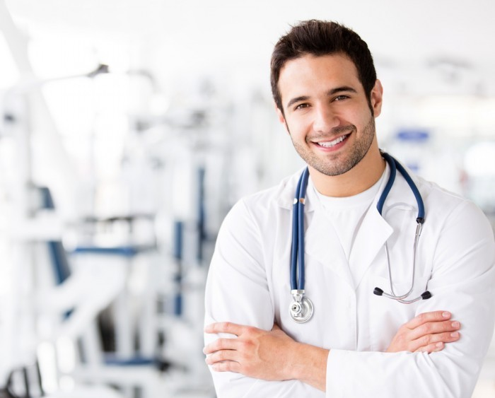

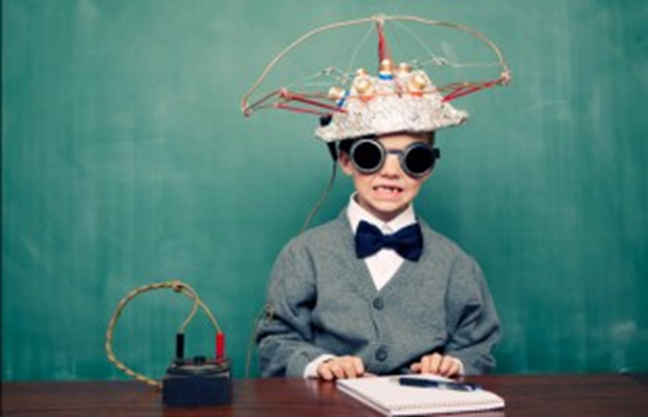
’
”’
”
”’
5
N
+
+
+

Slide 6



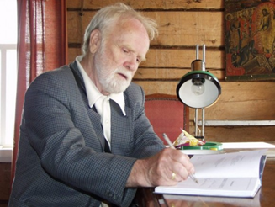
’
’
’
”
2
+
+
132

Slide 7


С
О
Е
1 = m
economist

Slide 8


1 = j
journalist

Slide 9
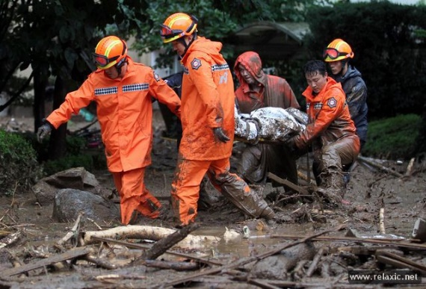
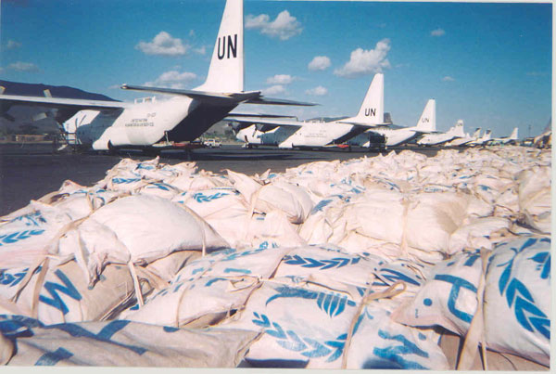
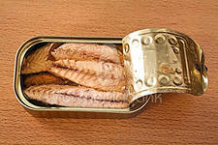
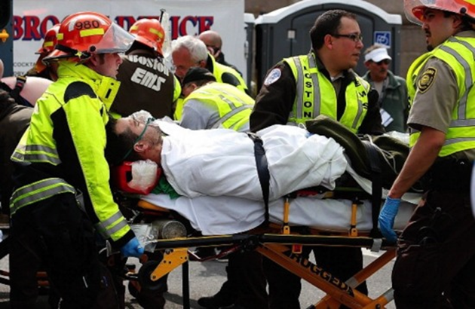
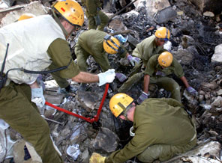
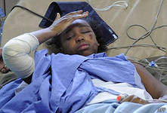
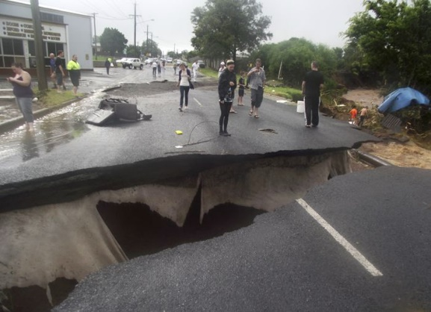
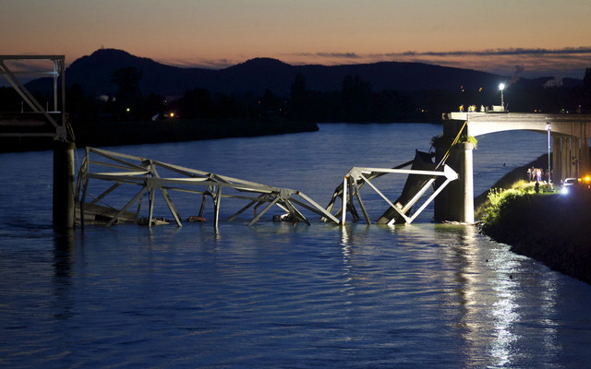
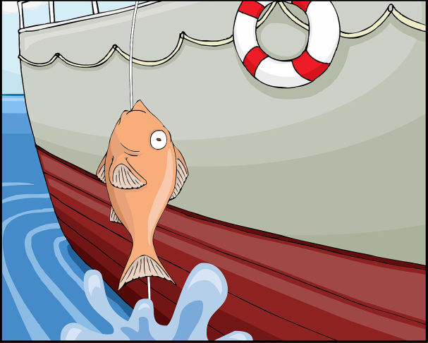
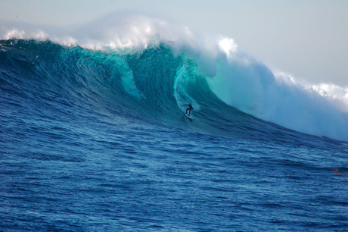
Let’s revise
Rescue team
Supplies (food supplies)
Tinned fish
Injured people
Survivor after a plane crash
To be buried
Cracked roads
Massive wave
Collapsed bridge
Pull out of water
Huge wave

Slide 10
Vocabulary list
Natural disasters
1. provisions
2. give out
3. fall down
4. with lines, damaged
5. people who have survived
6. take out
7. very early
8. to be wounded
9. happen
10. cause
11. catastrophe
Distribute
Disaster
Collapse
Pull out
Supplies
Cracked
Occur
To be injured
Generate
Early hours
Survivors

Slide 11
Past Perfect
+ | ? | -
S had + V3. | Had S + V3? | S had not + V3.
(+) He had read the book, before he saw the film.
(?)Had he read the book before he saw the film?
(-) He hadn’t read the book, before he saw the film.

Slide 12

Past Perfect
by 6 o’clock yesterday – вчера к 6 часам
by 9 a.m. yesterday – вчера к 9 утра
before he came – до того, как он пришёл
by that time – к тому времени
after - после того, как
by the end of the year – к концу года, etc.

Slide 13
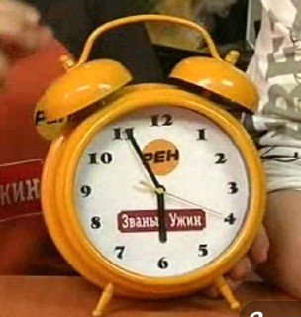
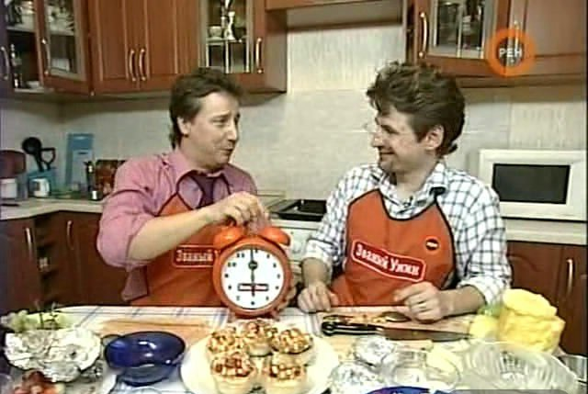
Roman
Roman had cooked dinner
by 6 o’clock yesterday.

Slide 14
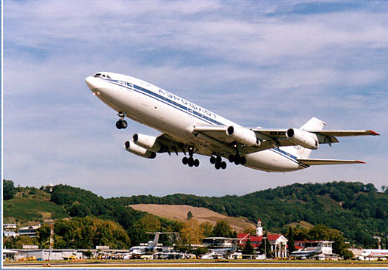
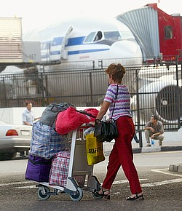
Arrive
Take off
Mrs. Evans
The plane had taken off before
Mrs. Evans arrived to the airport.

Slide 15
PRACTICE: Put the verbs in brackets in the correct tense.
When the accident ……. (happen) that lorry was driving like a lunatic. I ……
(never see) a lorry travelling so fast!
2. We …… (miss) the beginning of the play because it ….. (already start) when we arrived.
3. I …… (not recognize) my old teacher because we.....(not see) each other for 15 years.
4. When I ……(arrive) at her house I found she ……. (go out) so nobody was there.
5. My brother ……. (eat) all the cake before we …….. (get) home.
6. I ……. (understand) the film because I ……. (read) the book before.
7. Before she …… (buy) the flat she …… (look around) it several times.
8. I …… (not have) my book because I had ……. (lose) it the day before.
9. I ……. (study) English for two years before I …… (move) to N.Y.
10. She ……. (never see) a bear before she …... (move) to Alaska.

Slide 16
When the accident happened that lorry was driving like a lunatic. I had never seen a lorry travelling so fast!
2. We missed the beginning of the play because it had already started when we arrived.
3. I didn’t recognize my old teacher because we had not seen each other for 15 years.
4. When I arrived at her house I found she had gone out so nobody was there.
5. My brother had eaten all the cake before we got home.
6. I understood the film because I had read the book before.
7. Before she bought the flat she had looked around it several times.
8. I did not have my book because I had lost it the day before.
9. I had studied English for two years before I moved to N.Y.
10. She had never seen a bear before she moved to Alaska.

Slide 17
V + ING | TO + V | TO + V
Start Begin Stop Finish Spend Avoid Deny Look forward to Miss Consider Fancy Imagine Love Like Hate Involve Prevent Practise Dislike Enjoy Prefer Admit Suggest I don’t mind It’s not worth I can’t stand I can’t help There is no point in It’s no use It’s no good | Agree Appear Decide Want Expect Hope Plan Promise Refuse Would like Would love Would prefer | Let Make Feel Hear See Modal verbs (can, must, should, may, might)

Slide 18
Choose the correct item
1. Mark has decided to join/joining an environmental organisation.
2. People should use/ to use eco-friendly cleaning products, which are safer for the environment.
3. Neighbouring countries promised sending/to send supplies and rescue workers to the areas that were hit by the hurricane.
4. Judy didn’t let her children to go/go underwater diving.
5. Dan avoids buying/ to buy anything that cannot be recycled later.

Slide 19
Choose the correct item
6. I’ll never forget taking/to take part in a rescue mission for the first time.
7. Peter was looking forward to starting/ to start his new job at the animal shelter.
8. Volunteers from the area are spending this weekend
to clean/ cleaning up the local beach.
9. I can’t help wonder/ wondering whether our planet will ever recover from all the damage it has suffered.
10. If you want to help the earthquake victims, you can
to donate/ donate clothes and money at the local shelter.

Slide 20
Passive Voice
To be + V3/ed
 | Active Voice | Passive Voice
Present Simple | V1 / V+(e)s They write this poem. | Am/is/are + V3 This poem is written.
Past Simple | V+(e)d / V2 He wrote the poem. | Was/were + V3 The poem was written.
Future Simple | Will + V1 I will write the poem. | Will be + V3 The poem will be written.
Present Continuous | Am/is/are + Ving I am writing the poem. | Am/is/are being + V3 The poem is being written.
Present Perfect | Have/has + V3 She has written the poem. | Have/has been + V3 The poem has been written.
Modal Verbs | Modal Verb + V1 You can write the poem. | Modal Verb + be + V1 The poem can be written.

Slide 21
Письменно. Преобразуйте предложения в страдательный залог (Passive Voice) и укажите время.
Например, Someone stole my bicycle last week.- My bicycle was stolen last week. (Past Simple Passive)
1. My brother told me a boring story. - I ……
2. Keepers feed the elephants twice a day at the zoo. - The elephants …..
3. No one has identified the man yet. - The man …….
4. Someone is servicing my car today (at the garage). - My car ……
Someone cleans the windows of our flat once a month. - The windows …….
You cannot take pets into the theatre. – Pets…..
They had cooked the meal before the lights went off. – The meal……

Slide 22
HOMEWORK
Выполните задание на слайде 21 и отправьте своему учителю.
Ганиева Лейсан Фердинантовна- a_ljaisan@mail.ru , 89600582820
Гамбарова Лилия Талгатовна, sal_gamb17@mail.ru , 89050381115
Романова Марина Анатольевна, 14marina11@mail.ru , 89274455104

