Slide 1
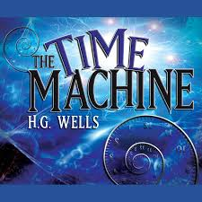

Slide 2
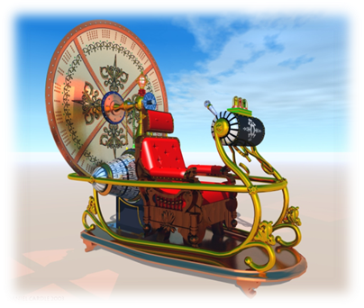
Time Travel Discussion
- Do you think time travel is possible?
- Would you prefer to travel to the past or the future?
- If you could travel to any time period in the past where and when would you travel?
- If you could travel back in time and change something that happened in the world would you?
- If you could know what was going to happen to you, would you want to know?

Slide 3
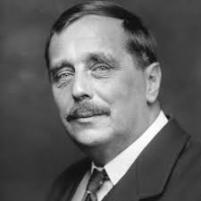
Biography Facts of H.Wells
Herbert George Wells was born at Atlas House, 46 High Street, Bromley, in Kent, on 21 September 1866. He was the fourth and last child of Joseph Wells and his wife, Sarah Neal. The family was poor, but they inherited some money which allowed them to buy a china shop.

Slide 4
Biography Facts of H.Wells
In 1877 his father injured his leg, so he sent his sons out to work. Wells worked as an apprentice in a fabric store, but he did not enjoy his work.
In 1883 he left the fabric store and became an assistant teacher at Midhurst Grammar School. He won a scholarship to the Normal School of Science in London.
Wells was not happy with the way society treated people differently. He dreamed of a world where all people were equal and expressed this desire through his works.

Slide 5
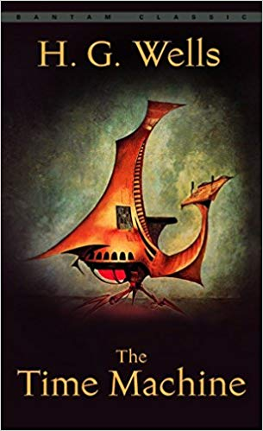
The Time Machine (1895)
The author describes a fantastic machine made of nickel, ivory and crystal and with great artistic mastery depicts the flight through time when days and nights seem like the flapping of a black wing.
The principal idea of the book is the contrast of the two degen­erated races - the Eloi and the Morlocks into which mankind has been divided. Having reached the year 802701, the Time Traveler meets the Eloi - beautiful and graceful, but utterly helpless creatures who live in dilapidated buildings surrounded by neglected gardens and the other race, the horrible and pale Morlocks, who resemble animals while living in the underground caverns .

Slide 6
Check the new words
Grow faint and hazy - become unclear
Confusedness - state of not clear or easy understanding
Peculiar - strange or unusual, especially in a way that is unpleasant or worrying
Succession - one thing following another thing
Imminent - likely to happen very soon
Scaffolding - construction for builders to stand on it
Dim - not bright

Slide 7
Match the expressions with feelings
Now find some more in the text

Slide 8
Complete with words. One is extra
Hazy, imminent, flickering, dim, faint, luminous
luminous
faint
hazy
imminent
dim

Slide 9
Homework
Краткое содержание романа Г. Уэллса
« Машина времени» (устно)

