Slide 1
Тема урока:
Повторение по теме «Окружающий мир. Природа: растения и животные».
Повторение по теме «Режим труда и отдыха».
Урок-обобщение пройденного за курс 5 класса.

Slide 2
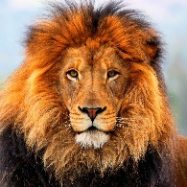
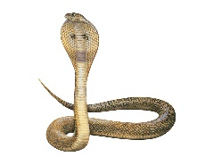
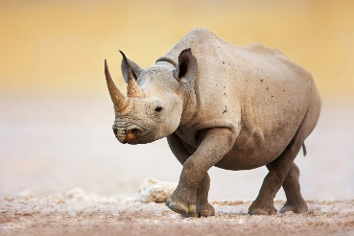
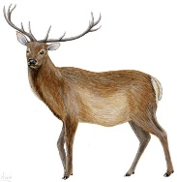
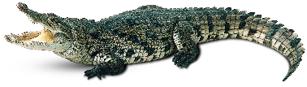
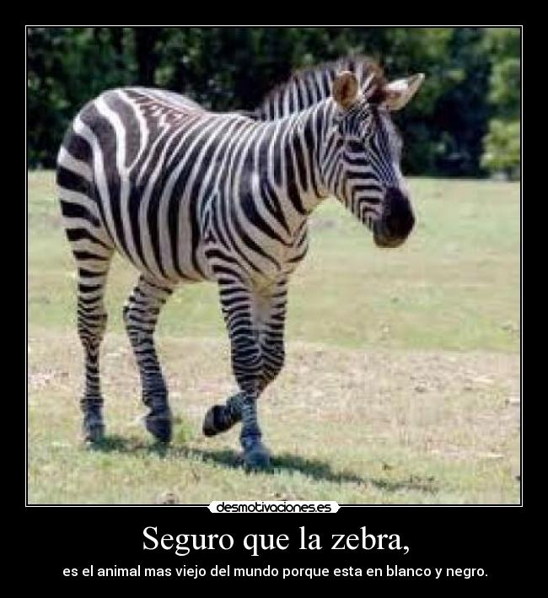
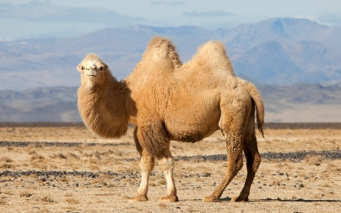
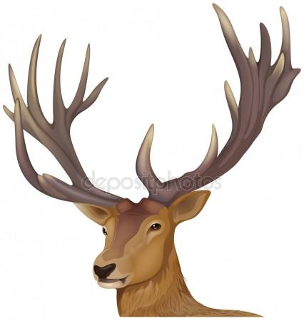
a lion
a cobra
a rhino
a crocodile
stripes
A deer
a camel
horn

Slide 3
Present Simple
обозначает
Permanent state (постоянное состояние) | Repeated action (повторяющееся действие) | Habits (привычка)
They live in Russia | He plays tennis every Monday | We have coffee in the morning

Slide 4
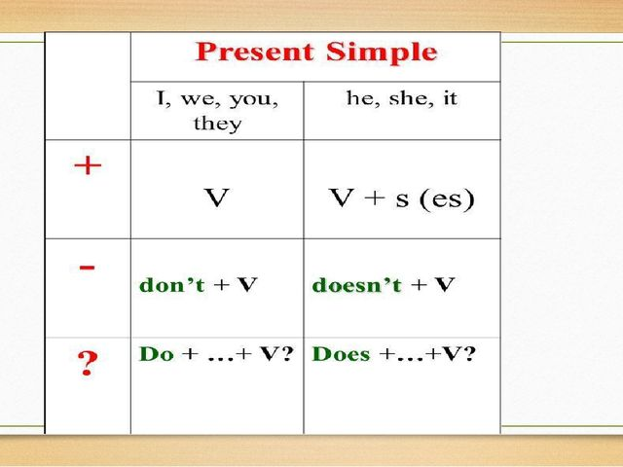

Slide 5
Сигнальные слова
always
usually
often
sometimes
every day(week/month/year)
in the morning/afternoon/evening
on Monday(s), Sunday(s)

Slide 6
Раскрой скобки, употребляя Present Simple.
Rhinos ……. (eat) plants.
The Bengal tiger …… (live) in India.
A lion ……. (sleep) during the day.
Crocodiles ……. (swim) in rivers.
Elephants ……. (like) bananas.

Slide 7
Проверь себя
Rhinos eat plants.
The Bengal tiger lives in India.
A lion sleeps during the day.
Crocodiles swim in rivers.
Elephants like bananas.

Slide 8

The Present Continuous Tense
(Настоящее длительное время)
употребляется для обозначения действия, происходящего в данный момент, в момент речи или в период времени, включающий данный момент.
V – verb (глагол)
V
TO BE
ing
am
is
are
I
he
she
it
you
we
they
AT THE MOMENT
NOW

Slide 9
Раскрой скобки, употребляя Present Continuous
My dad _____(paint) the house today.
The children ____ (not watch) TV now.
They ____ (do) their homework.
_____ (John/repair) his car? – Yes, he is.
What ____(you/do), Mike?
I _____ (write) an email to my friend.

Slide 10
Проверь себя
My dad is painting the house today.
The children aren’t watching TV now.
They are doing their homework.
Is John repairing his car? – Yes, he is.
What are you doing, Mike?
I am writing an email to my friend.

Slide 11
Homework
Изучить презентацию, повторить лексико-грамматический материал.

