Slide 1


Objective for today:
- revision of Module 8

Slide 2
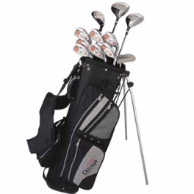
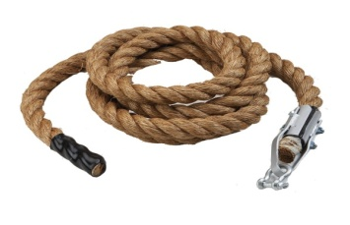
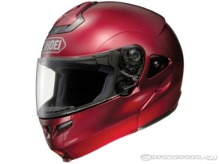
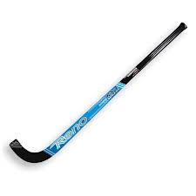

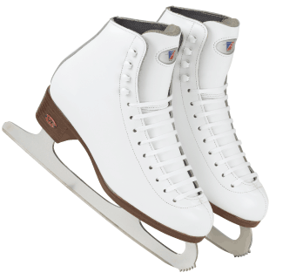
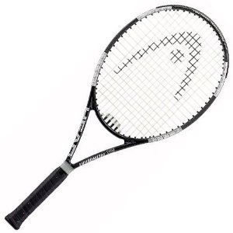
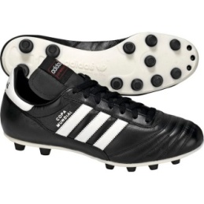

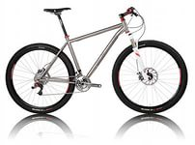
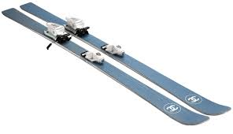
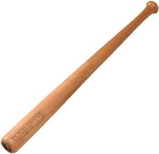


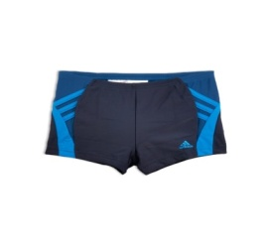

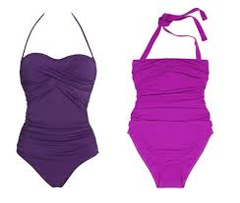
Equipment and sport activities
If I played/went/ did I would use….
cricket
rugby
badminton
long jump
tennis
water polo
javelin throwing
volleyball
scuba diving
hurdles
ice hockey
basketball
snowboarding
jogging
climbing
cycling
football
golf
swimming

Slide 3
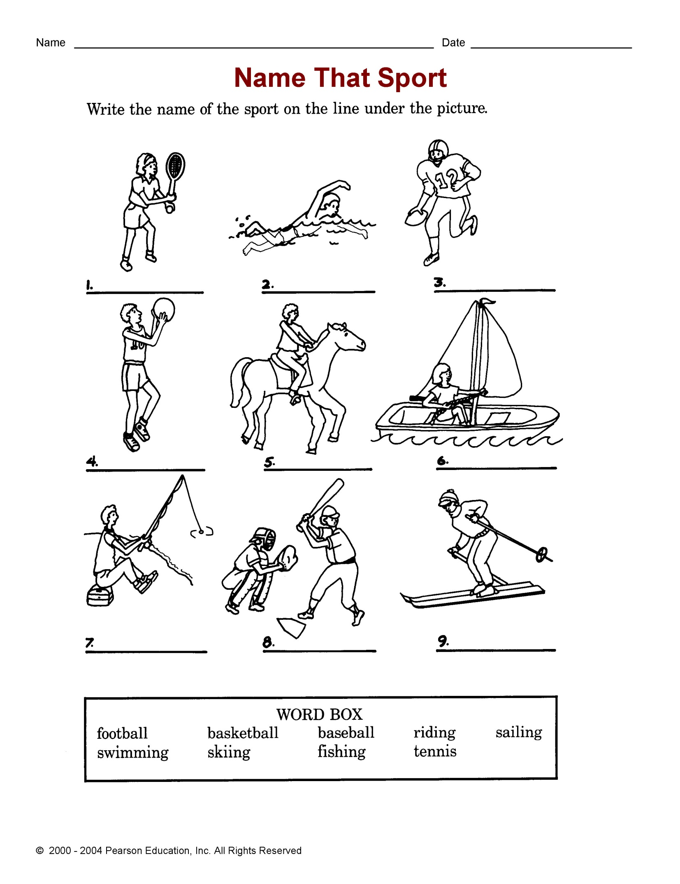
Name the sport

Slide 4
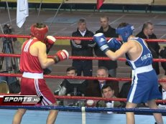
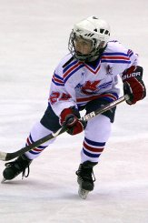
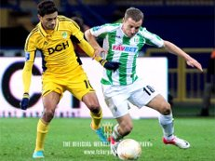
Guess the sport
– a ring and gloves
– skates and two goals
– a ball and two goals

Slide 5
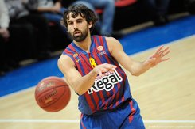
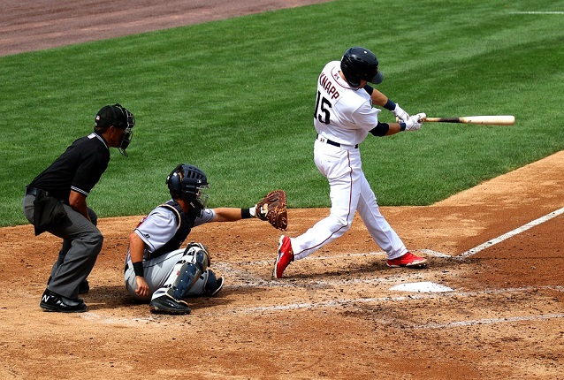
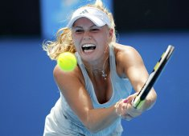
Guess the sport
– a ball, a basket and hands
– a ball, a bat and a glove
– a ball, a racquet and a court

Slide 6
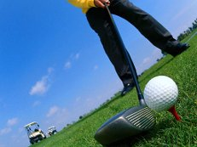
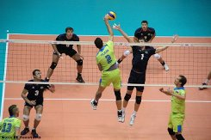
Guess the sport
– a ball and lawn
– a net and a ball

Slide 7
Раскройте скобки. Напишите тип условного придаточного предложения.
1) If she weren’t so lazy, she ____ (become) a brilliant student.
2) I am not sure what I am doing tonight, but if I go out, I _______ (phone) you.
3) If Steve hadn’t bought a lottery ticket, he _____ (not/win) $1 million.
4) Dairy products keep longer if you ____ (put) them into the fridge.
5) She would not have stolen the food if her child________ (not/be) hungry.
6) If you _______ (leave) ice in the sun, it ______ (melt).
7) If Jack had planned it carefully, he ________ (not/have) so many problems.
8) He is a very wise person. I _______ (speak) to him if I were you.

Slide 8
2. Составьте предложения. Укажите тип условного придаточного предложения.
1. gone / visit/ known / you / were / hospital / if / I’d / have / I’d / to/ in / you
2. have / we / find / had / been / compass / wouldn’t / if / a / able / to / our / way / hadn’t / we
3. it / window / stopped / have / ball / if / wouldn’t / broken / the / the / you’d
4. I’d / my / race / broken / I / won / if / have / leg / that / hadn’t
5. we’d / have / caught / earlier / our / if / we’d / arrived / train

Slide 9
3. Вставьте слова. Pitch, court, course or rink:
1) Soccer, American football and baseball are played on a __________.
2) Tennis, volleyball, and basketball are played on a ___________.
3) Hockey and figure skating are in an ice ____________.
4) Golf is played on a golf _____________.
4. Вставьте слова. Win, beat or gain:
1) _________ a game
2) _________ an opponent
3) _________ a medal
4) _________ time
5) _________ support

Slide 10
HOMEWORK
Выполнить письменно задания на слайдах 7, 8, 9 и отправить своему учителю. Повторить лексико-грамматический материал модуля 8.
Ганиева Лейсан Фердинантовна- a_ljaisan@mail.ru , 89600582820
Гамбарова Лилия Талгатовна, sal_gamb17@mail.ru , 89050381115
Романова Марина Анатольевна, 14marina11@mail.ru , 89274455104

