Slide 1


Character qualities
Повторение лексико-грамматического материала за курс 10 класса
Vocabulary

Slide 2
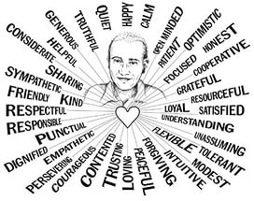
Character qualities

Slide 3
Let`s revise the vocabulary
Aggressive
Caring
Creative
Dedicated
Honest (dis)
Fair
Jealous
Loyal
Mean
Patient
Respected
Selfish
Supportive
Trusting
Well-meaning
Reliable
Moody

Slide 4


Which qualities do you
look for in your friend?
Which do you try to avoid?
Use:
To me,
As for me,
In my opinion,
To my mind,
In my view,

Slide 5


Homework: write a cinquain
на английском языке!!!
Friend
1 строка – существительное
2 строка – два прилагательных, характеризующих существительное в первой строке
3 строка – три глагола, описывающие действие существительного с первой строке (в английском языке это глаголы в неличной форме - герундий)
4 строка – фраза, характеризующая существительное с первой строке
5 строка – существительное (синоним к существительному в первой строке )

Slide 7
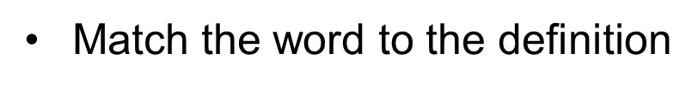
1. He’s always helping the elderly.
2. Emma rarely gets annoyed with her little sister.
3. He’s very unkind to others.
4. He hates it that I spend most of my time with classmates.
5. He is determined to win.
6. First she smiles, the next minute she cries.
7. My best friend will never betray me. He is very …

Slide 8
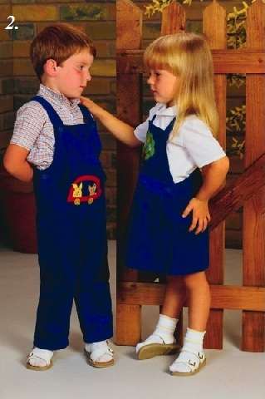

Idioms
See eye to eye
Sisters often don`t
see eye to eye.

Slide 9
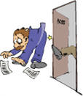
Like a bear with a sore head
What's wrong with
Jack? - He's like a bear
with a sore head

Slide 10
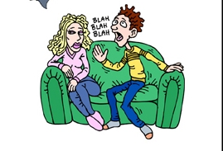
Get off one`s back
Get off my back!
I`m in a bad mood.

Slide 11
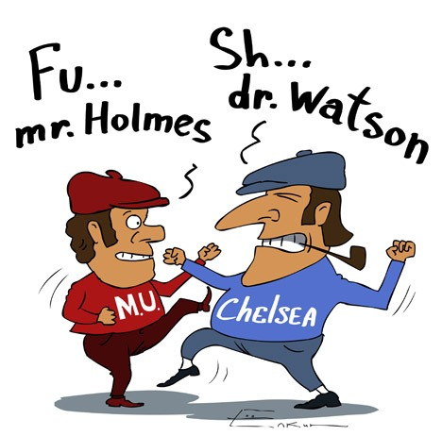
Get on one's nerves
I'm fed up with you.
You really get
on my nerves.

Slide 12
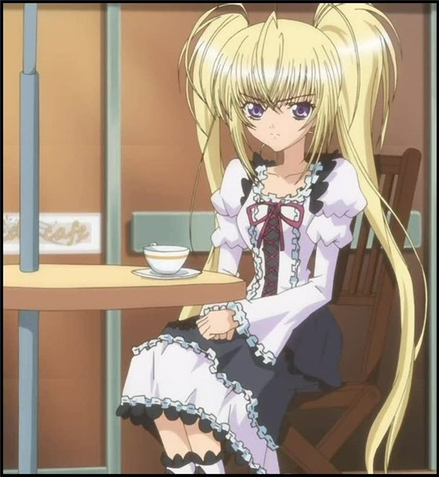
Give smb the cold shoulder
He gave me the cold shoulder last night.

Slide 13
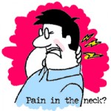

A pain in the neck
He drives me crazy. He's a pain in my neck.

