Slide 1



Повторение по теме: «Общение в семье и в школе». Повторение по теме: «Современная молодежь».

Slide 2
Stress
Module 2

Slide 3
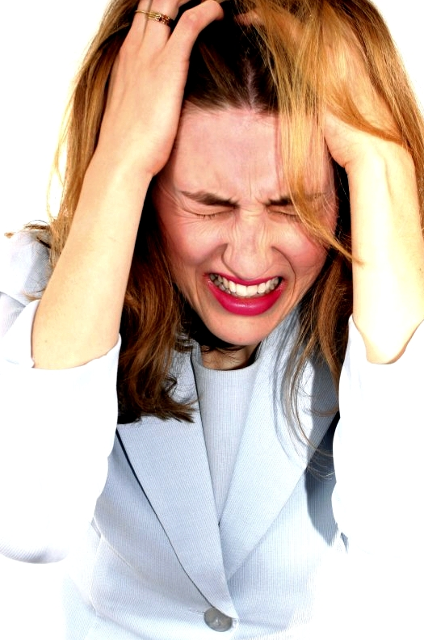
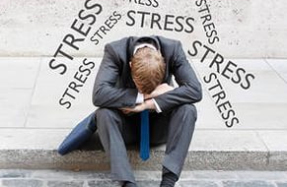
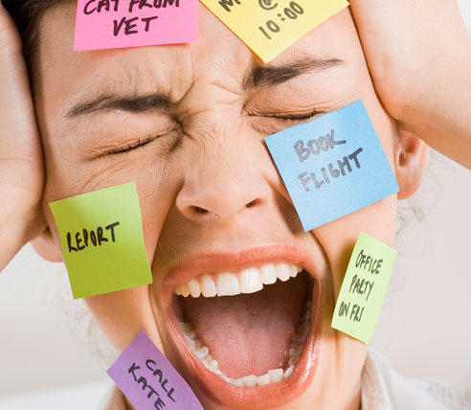
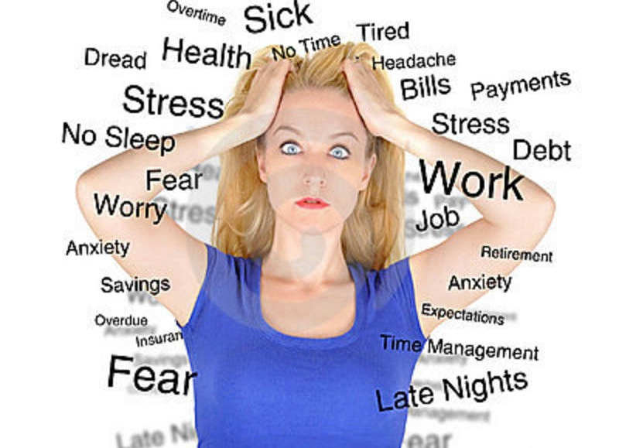
Stress

Slide 4
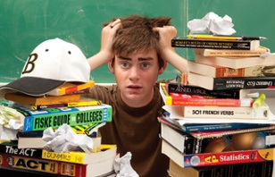
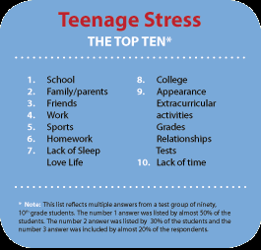
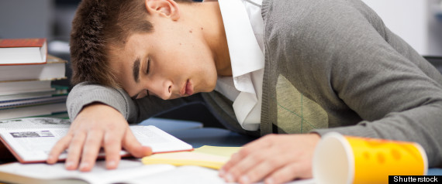

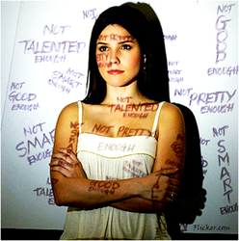

Why?

Slide 5
Stressful statistics
Annual psychological survey focuses on teens for the first time
Teen stress level is higher than adult level
Teens with high-stress lives are potentially at risk of chronic stress and chronic illness
Stress survey finds teen girls report higher stress and more symptoms than boys

Slide 6
Idioms
in a nutshell
keep smb on one’s toes
get out of hand
lighten the load
grin and bear it
keep things in perspective
pull one’s hair out
take one’s mind off smth
get smth off one’s chest
be up to one’s eyes in smth
get things out of proportion
give smb a hard time
lose one’s temper
H/W: Use any 9 idioms in a story
of your own

Slide 7
Mind the prepositions
in the run-up TO … smth
the lowdown ON … smth
do ABOUT smth
react TO smth
IN the long term
AT a time
count TO (ten)
cope WITH smth
be UNDER stress
Make up sentences with these phrases.

Slide 8

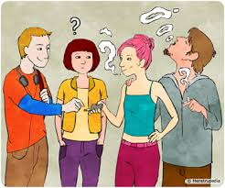
Peer Pressure
Peer pressure social pressure by members of one's peer group to take a certain action, adopt certain values, in order to be accepted.

Slide 9
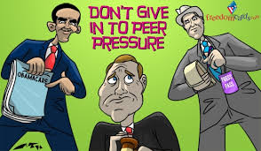
Handling peer pressure
What can you suggest doing to handle peer pressure?
Watch the tips and check!

Slide 10
Homework: idioms
one in a million
a hundred and one reasons
at sixes and sevens
in two minds
six of one and half a dozen of the other
There are ______________why you should resist peer pressure. It’s not even worth being __________! Boost your confidence and self-esteem (frankly speaking, they are _____________) and remember you are unique, _______________. You must be strong and assertive. Are you still _______________? Come on, you can do it!
Электронные адреса учителей:
Ганиева Лейсан Фердинантовна:
a_ljaisan@mail.ru (89600582820)
Романова Марина Анатольевна :
14marina11@mail.ru (89274455104)

