Slide 1
REVISION
Module 6
Town & Community

Slide 2

Complete the sentences with the following words:
library
a cinema
a post office
a museum
a sports centre
a theatre
an art gallery
a supermarket
a police station
a pharmacy
You can look at paintings at
You can send a letter at
You can borrow a book from
You can buy food at
You can watch films at
You can see plays at
You can play tennis and football at
You can look at old objects at
You can find a police officer at
You can buy medicine at

Slide 3
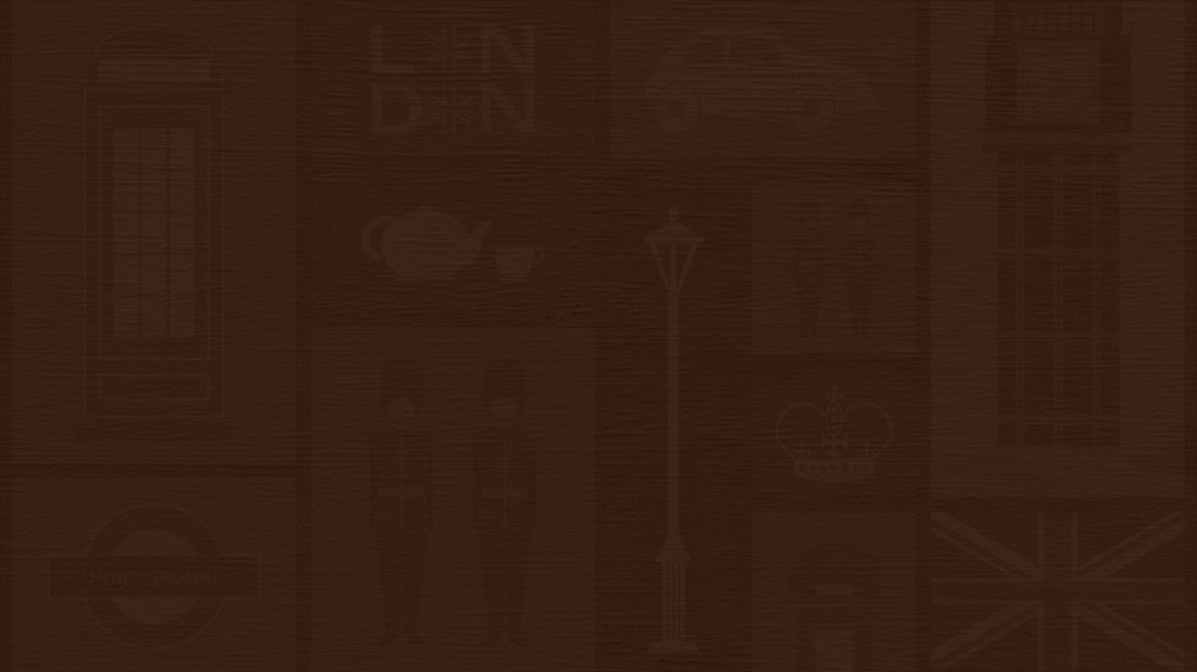
Quiz:
World monuments

Slide 4
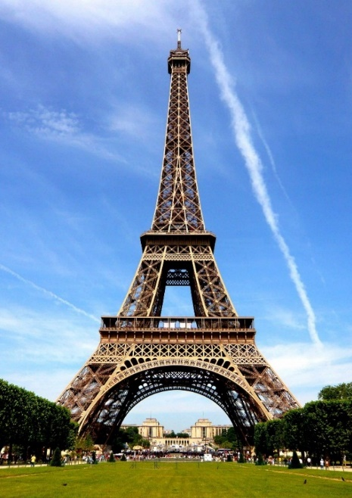
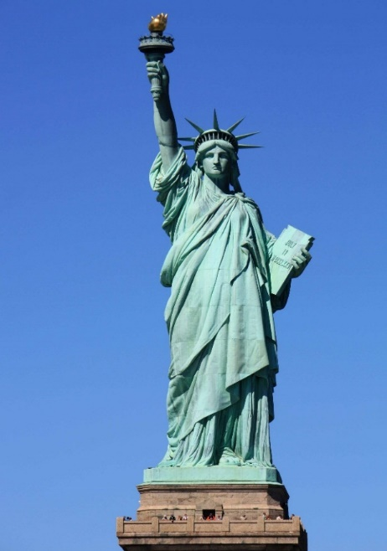
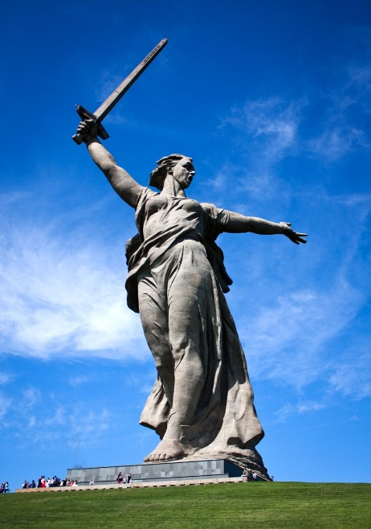
1
Which tower has the nickname “the iron lady”?
a) The Eiffel Tower
a) The Eiffel Tower
b) The Statue of Liberty
c) The Motherland Calls
Did you know that the heat of the sun causes the tower to grow about 6 inches?

Slide 5
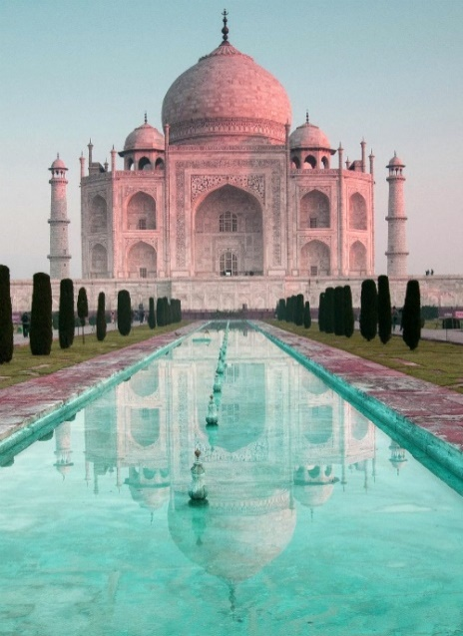
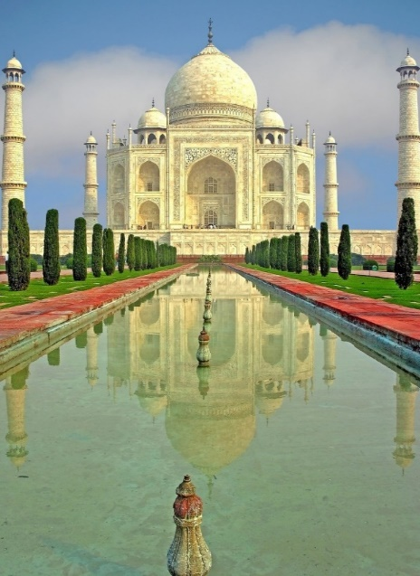
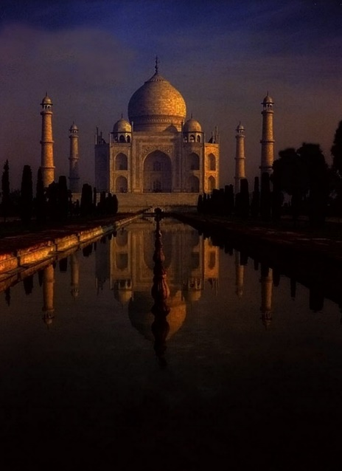
2
At the different time of the day Taj Mahal appears to be in a different colour every time.
What material was the Taj Mahal made of?
a) red sandstone
b) white marble
b) white marble
c) gold
Many types of marbles were used in construction of Taj Mahal.
It appears pink in the morning, white in the day and it changes to golden in the moonlight.

Slide 6
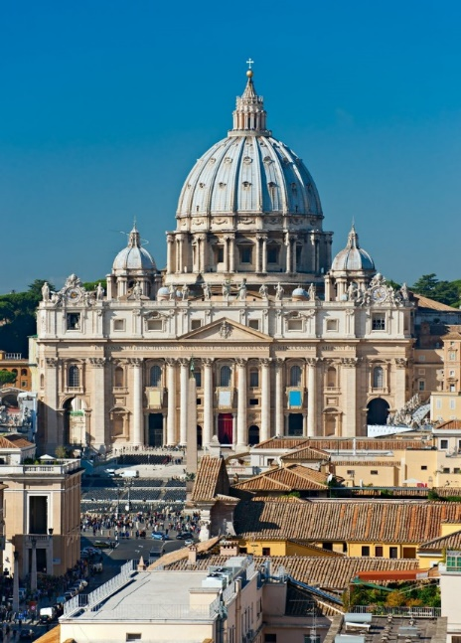
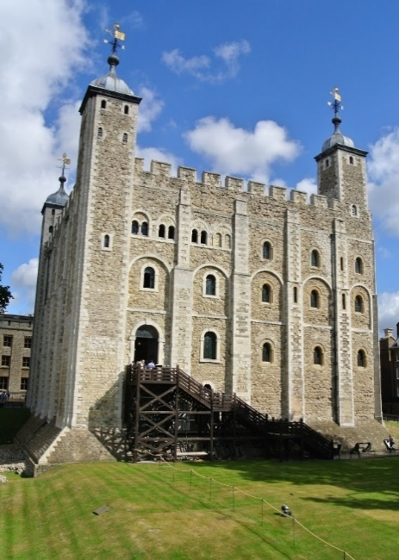
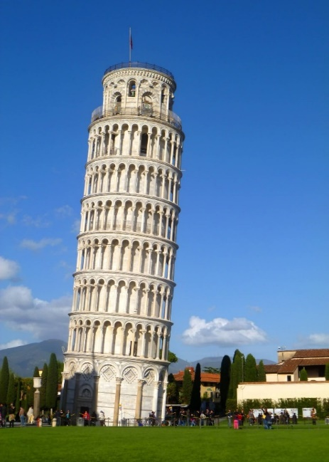
3
According to the legend, which famous building will be destroyed if the ravens ever leave it?
a) St Peter’s Cathedral, Vatican City
b) The Tower of London
b) The Tower of London
c) The Leaning Tower of Pisa
7 ravens are kept at the Tower of London at all times – 6 of whom make up the number of ravens that is said to need to remain in order to protect the crown, and 1 of whom acts as a back up … just in case!
The ravens are an enduring symbol of Monarchy, tradition, and history at the Tower of London.

Slide 7
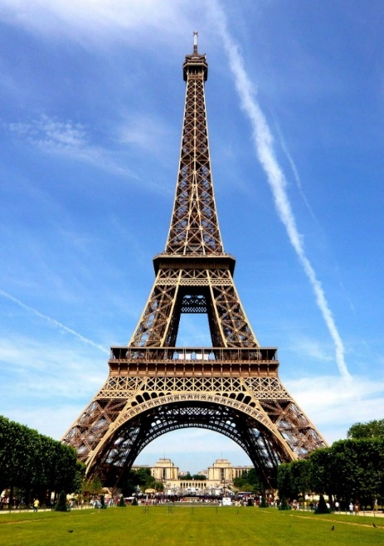
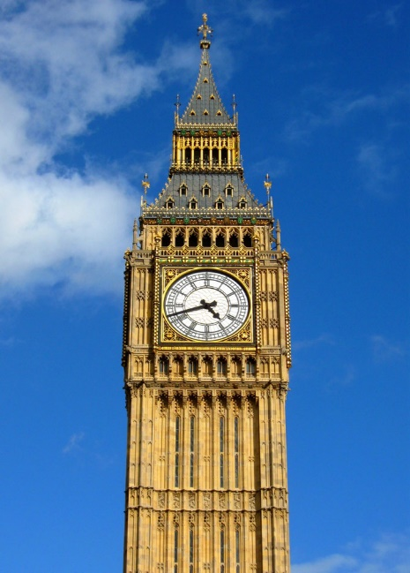
Which is the smallest tower to have achieved worldwide recognition?
4
a) The Leaning Tower of Pisa
c) Big Ben
a) The Leaning Tower of Pisa
b) The Eiffel Tower
The Leaning Tower of Pisa is only 55.86 meters tall.
It stood straight only for 5 years upon completion of its initial construction and then started leaning towards one side.
In 1999 the architects decided to remove ground from the high side.
They straightened the tower by about 16 inches and returned it to the position it held in 1838.

Slide 8
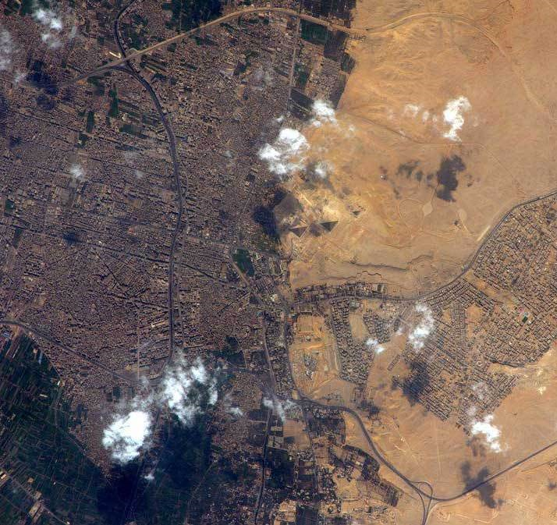
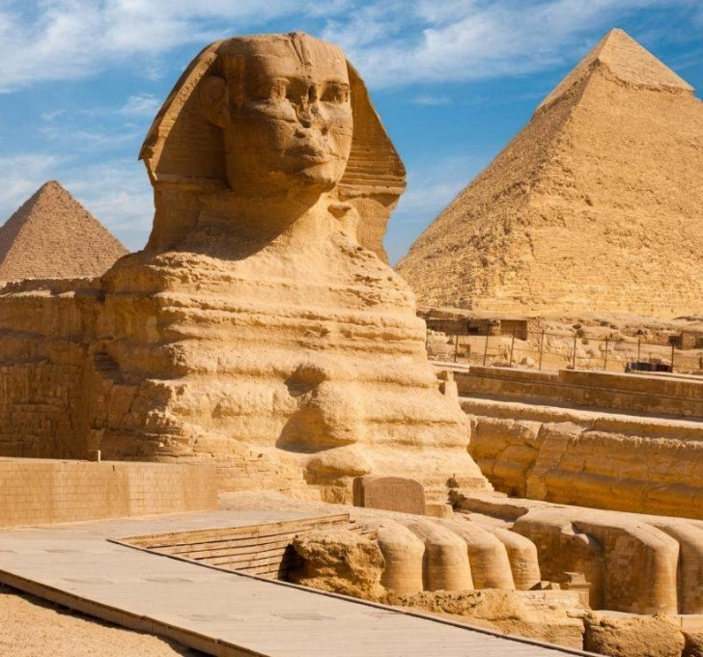
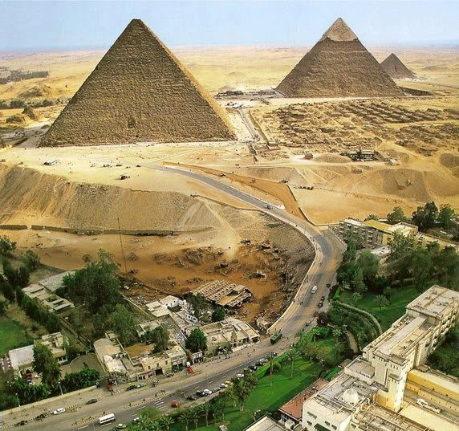
5
Why were the Egyptian Pyramids built?
Did you know that the features of the Great Pyramid of Giza are so large they are visible even from the Moon!
b) as tombs for the pharaohs
a) as monuments to the gods
b) as tombs for the pharaohs

Slide 9
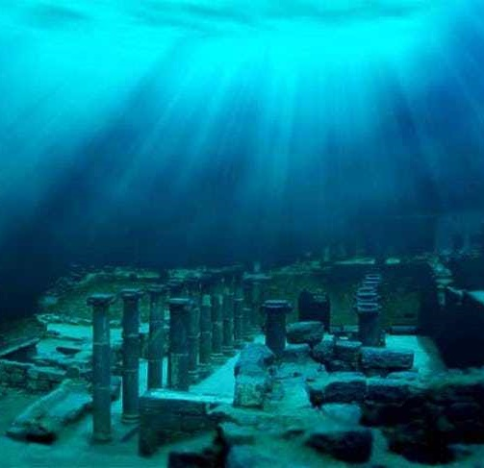
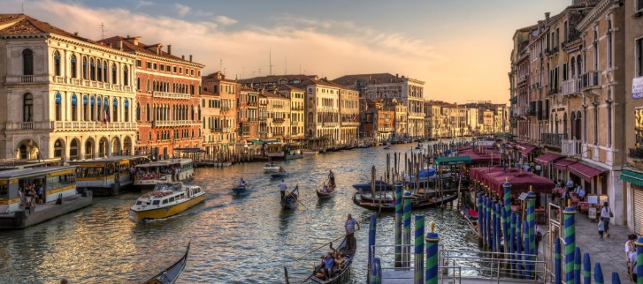
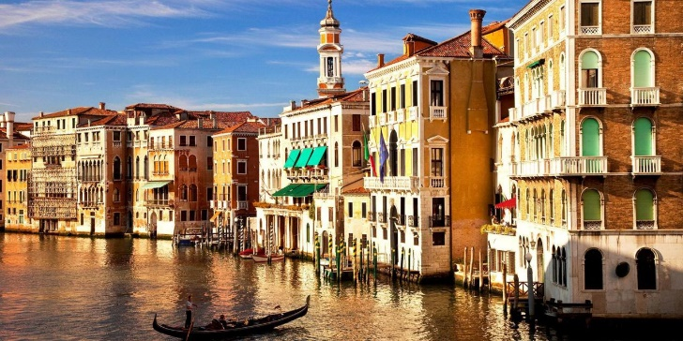
6
What city is known as “the city on water”?
Atlantis is the city "under" the sea, if to believe in legends. Scientists have not found it yet.
a) Atlantis
b) Venice
b) Venice

Slide 10
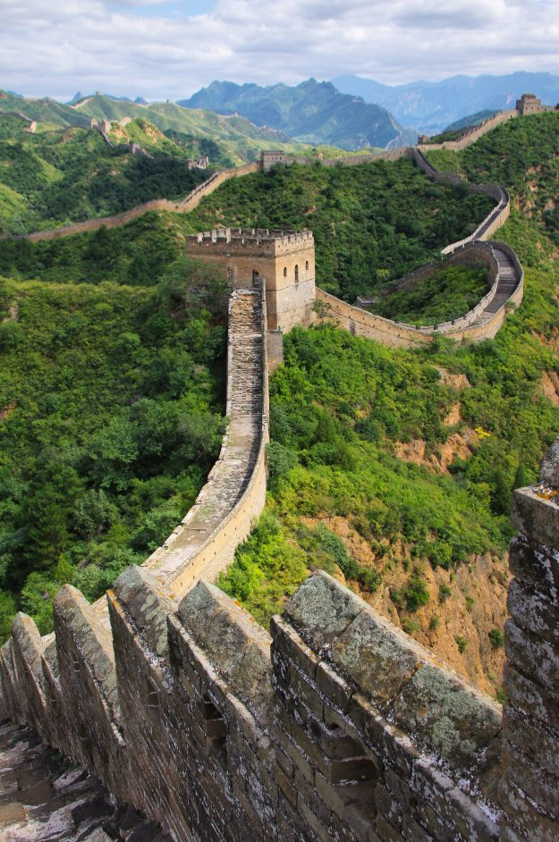
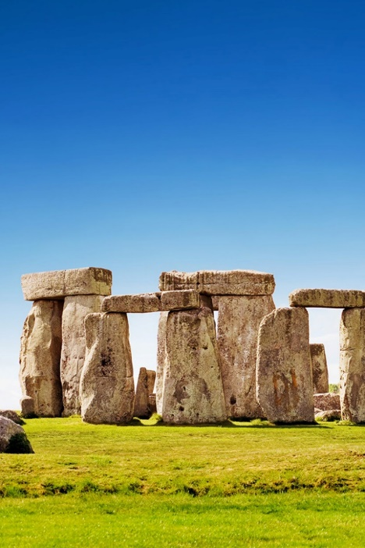
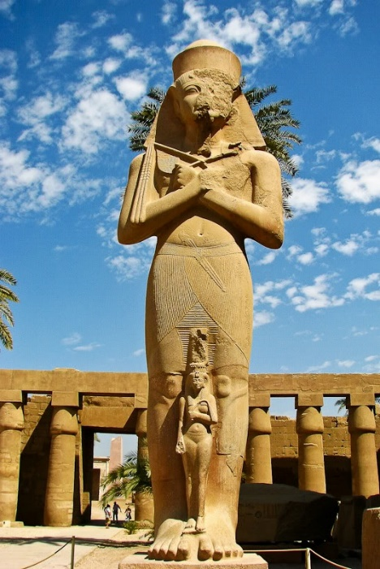
7
They say that 2 to 3 million people died while building a monument. Which one?
a) the Great Wall of China
a) the Great Wall of China
b) Stonehenge, England
c) Luxor Temple, Egypt
The length of the Great Wall of China is 21, 196 km.

Slide 11
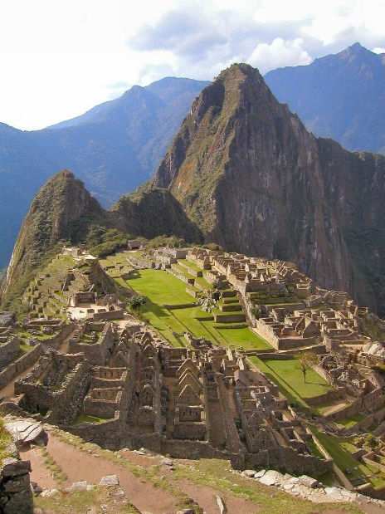
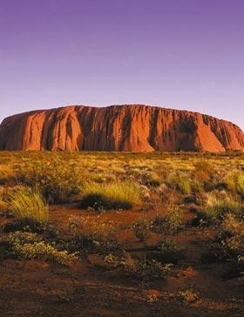
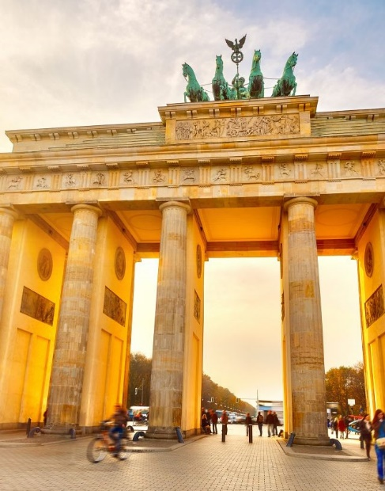
8
Which of these famous sites is endangered by tourism?
a) Machu Picchu, Peru
b) Uluru, Australia
c) Brandenburg Gate, Germany
a) Machu Picchu, Peru
Machu Picchu is also called the “City of the Incas”.
UNESCO added it to their list of World Heritage Sites in Danger. In an effort to reduce damage caused by tourism, various restrictions have been placed on the number of people admitted to the site each day.

Slide 12
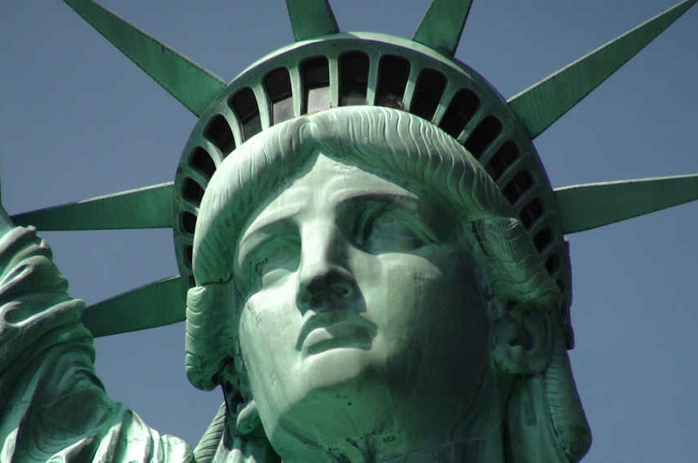


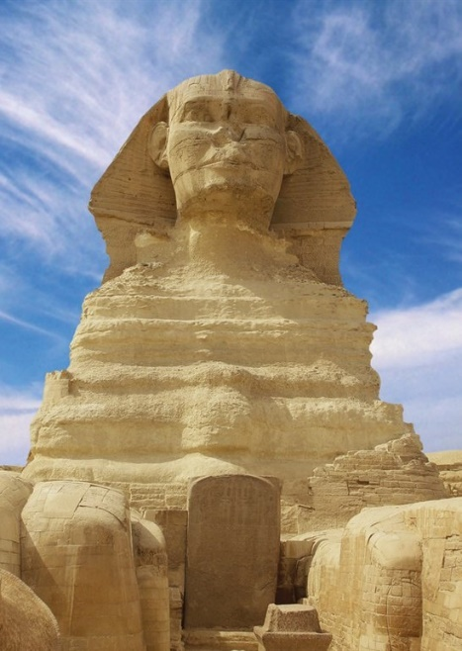
Which monument had been transported from the Old World to the New World?
9
a) The Statue of Liberty
b) The Eiffel Tower
c) The Great Sphinx
a) The Statue of Liberty
The Statue is a gift to the United States from the people of France which commemorates the American Declaration of Independence, July 4, 1776.
There are 25 windows in Lady Liberty’s crown to allow the visitors to have a panoramic view of the vicinity.

Slide 13
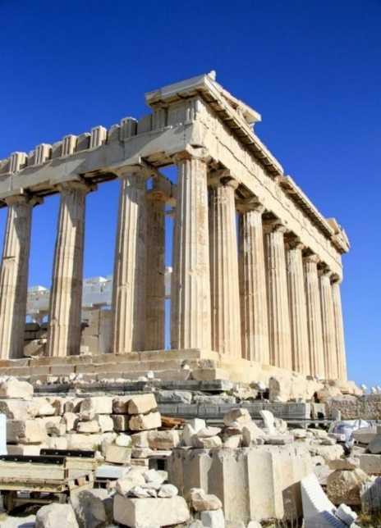
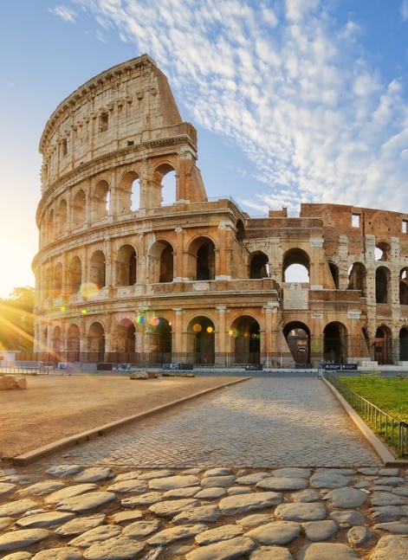
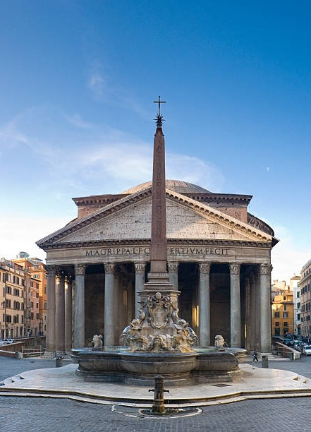
10
Which famous building did the Romans use for gladiator duels and public spectacles?
b) the Colosseum
a) the Acropolis
b) the Colosseum
c) the Pantheon
Historical data suggests that the games played in the Colosseum for hundreds of years have claimed the lives of about 500,000 people and more than a million wild animals.

Slide 14
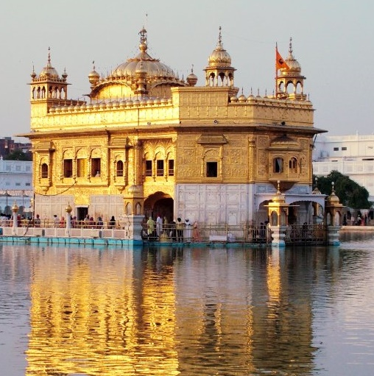
11
Why is the temple of Sikhs in India called “The Golden Temple”?
a) it is painted in yellow
b) it is made of gold
c) it is made of sandstone
The Golden Temple is regarded as the most sacred place of worship for the Sikhs.
It is mostly made of marble but it is gold plated with real gold.

Slide 15
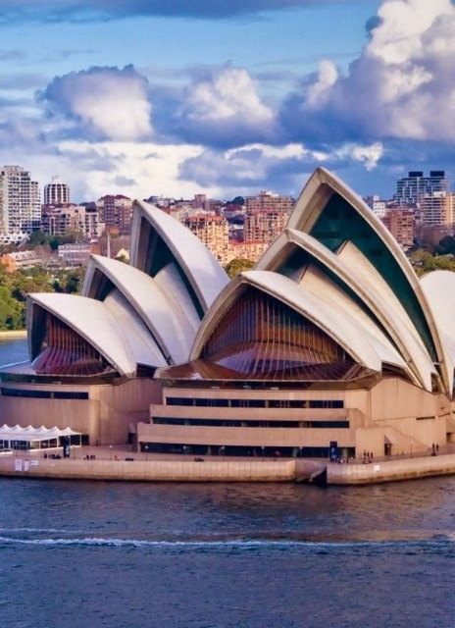
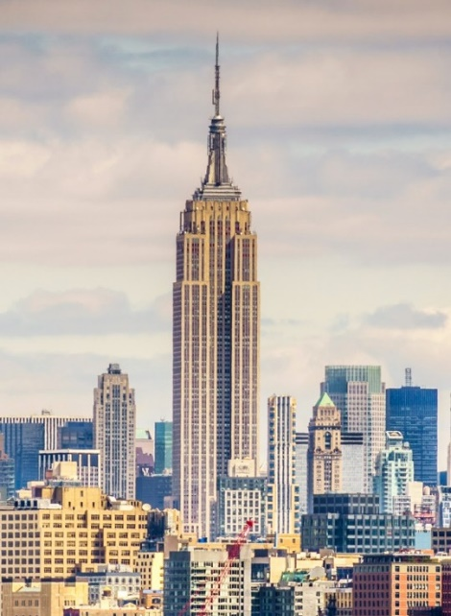
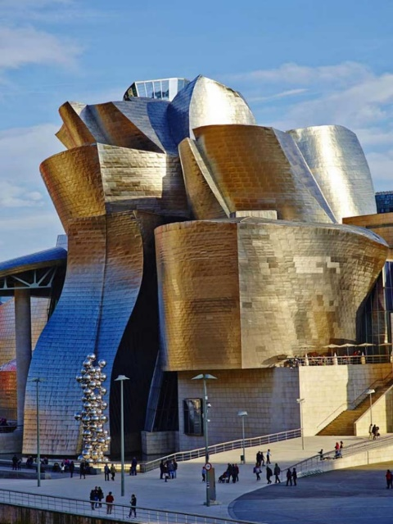
12
Which famous building resembles the swollen sails or the giant shells?
a) The Sydney Opera House, Sydney
b) Empire State Building, New York
c) Guggenheim Museum, Bilbao
a) The Sydney Opera House, Sydney
?
?
?

Slide 16
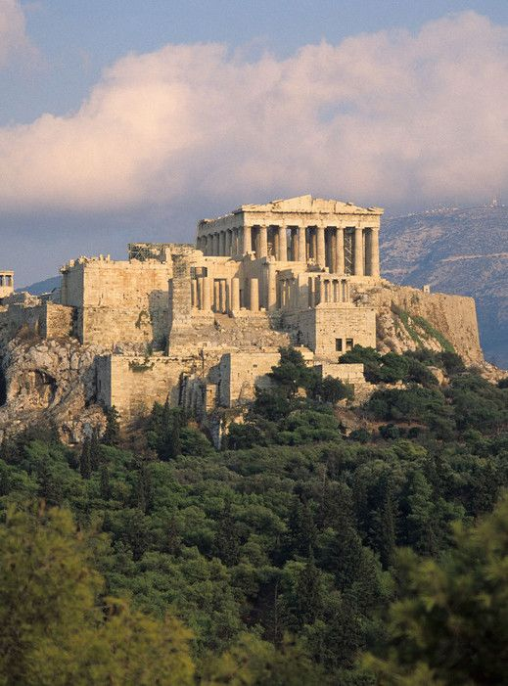

13
a) the Acropolis, Athens
b) the Colosseum, Rome
a) the Acropolis, Athens
Which famous monument can be seen from almost every part of the city?
The Acropolis stands on the hill that overlooks the city of Athens.

Slide 17
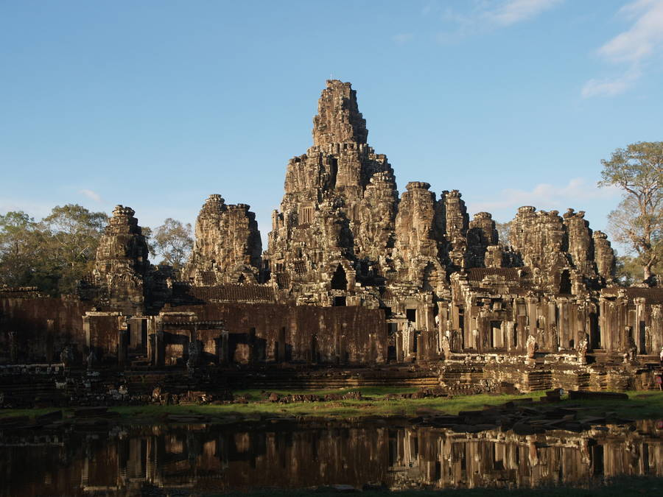
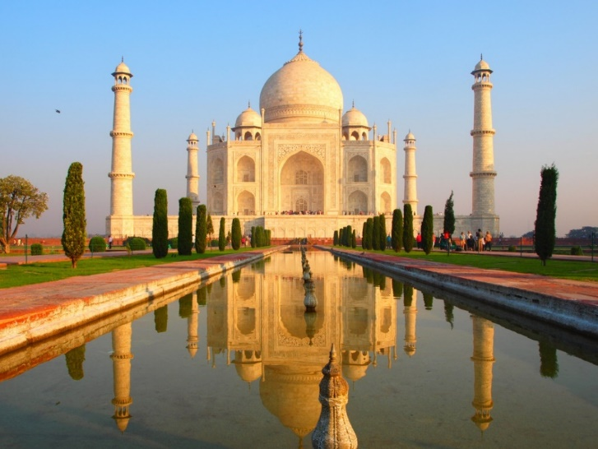
Which temple was built as a home of the Hindu gods?
14
a) the Phnom Bakheng, Cambodia
a) the Phnom Bakheng, Cambodia
b) the Taj Mahal, India
It is nowadays a popular tourist spot.
The large number of visitors makes Phnom Bakheng one of the most threatened monuments of the South Asia.

Slide 18
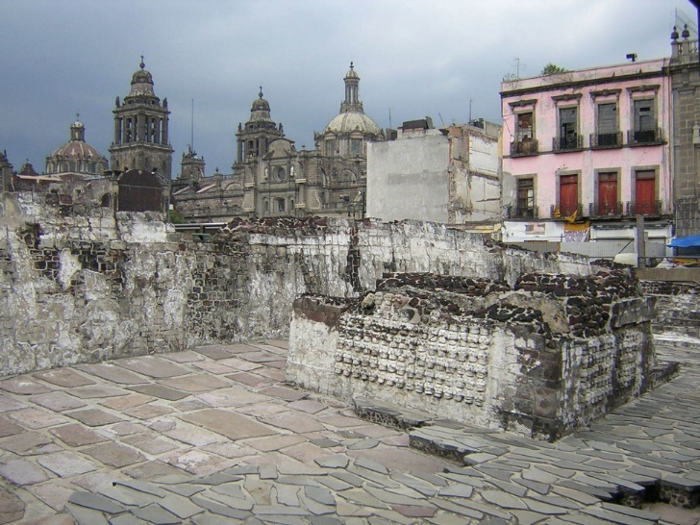
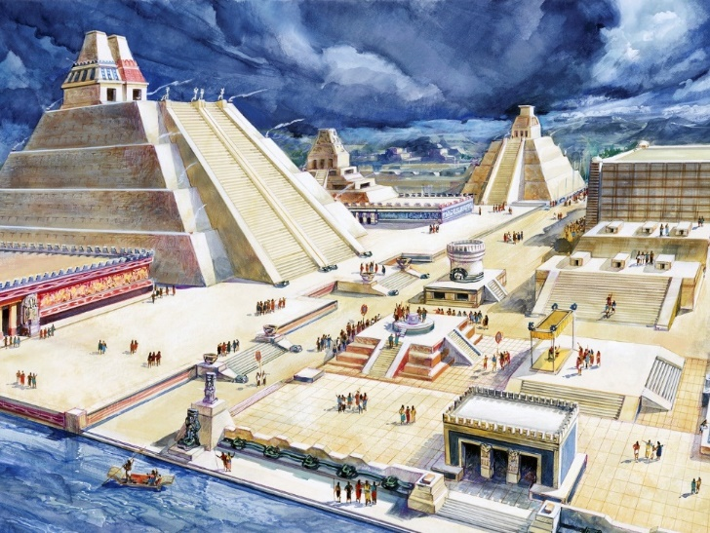
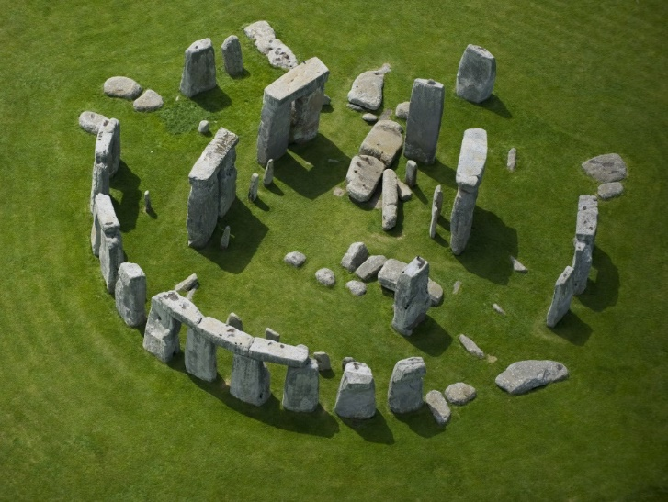
It was destroyed by Spanish conquistador Hernan Cortes. Which one?
15
a) Tenochtitlan, Mexico
a) Tenochtitlan, Mexico
b) Stonehenge, England
The city was the capital of the expanding Aztec Empire in the 15th century until it was captured by the Spanish in 1521.
Cortés wrote that Tenochtitlan was as large as Seville or Córdoba (the biggest cities at that time). It was five times the size of the London of Henry VIII.

Slide 19
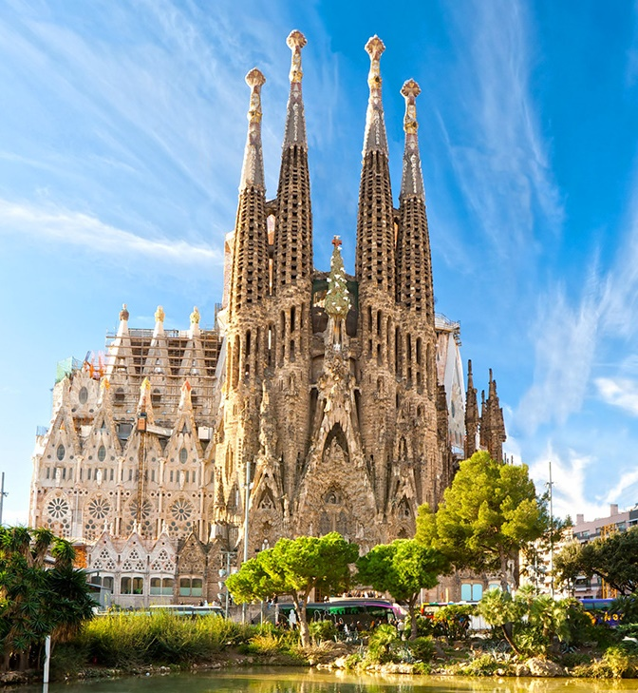
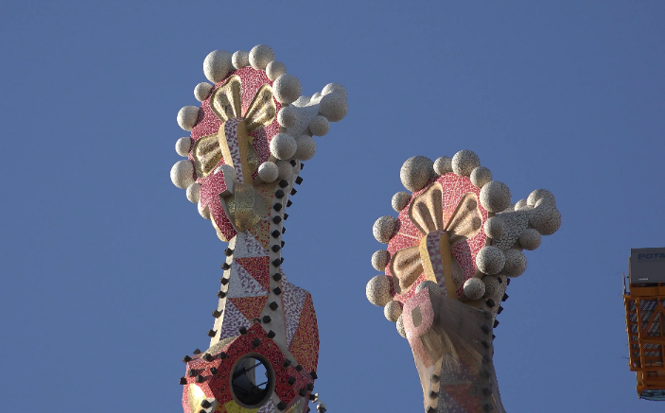
What famous architectural masterpiece can you see in this picture?
16
Petronas Towers, Malaysia
Saint Basil’s Cathedral, Russia
Sagrada Familia, Spain
Sagrada Familia is one of the greatest works of Antoni Gaudi.
Gaudi died well before finishing the basilica.
There are only 8 of the planned 18 towers completed.
When Gaudi was asked why he was putting so much time and effort in making the tops of the spires so elaborate, when no one could see them properly.
He responded, “The angels will see them”.

Slide 20
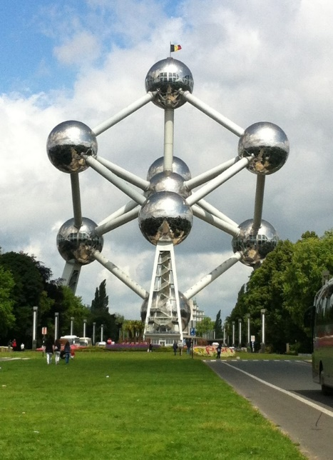
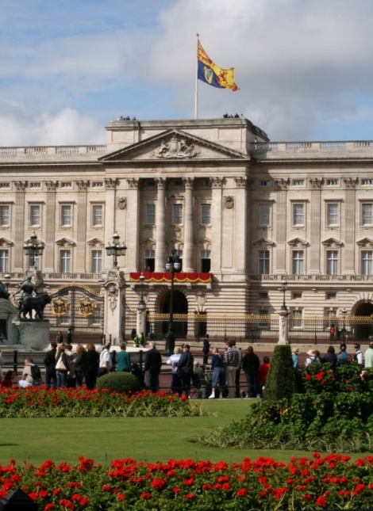

Until 2016 it was strictly banned to take photos and videos of this modern construction in Brussels. Which one?
17
a) Atomium
a) Atomium
b) Buckingham Palace
c) Brandenburg Gate

Slide 21
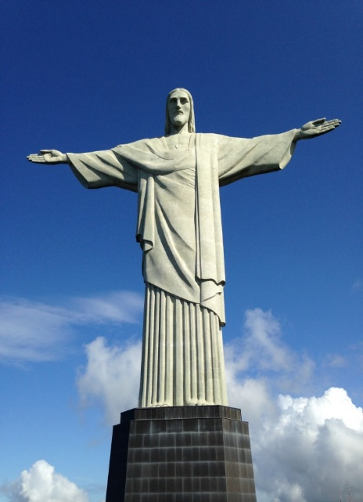

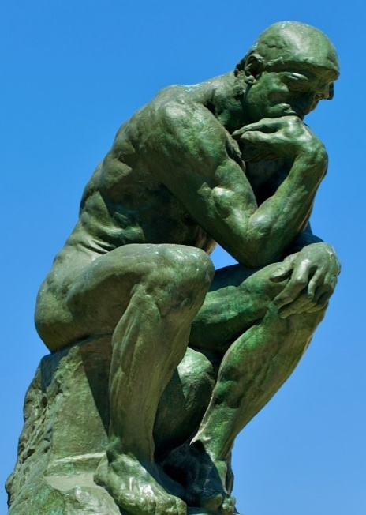
Which statue became a symbol of Christianity across the world?
18
a) Christ the Redeemer
a) Christ the Redeemer
b) The Great Sphinx Of Giza
c) The Thinker
A symbol of Christianity across the world, the statue has also become a cultural icon of both Rio de Janeiro and Brazil.

Slide 22
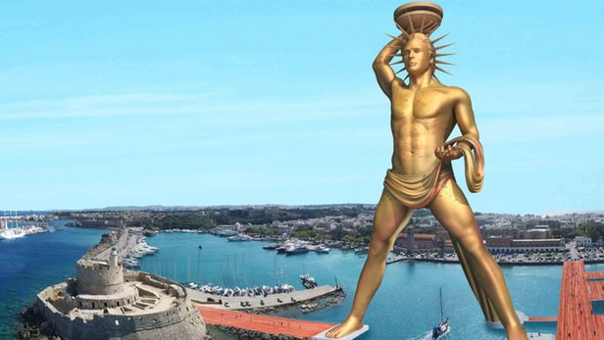
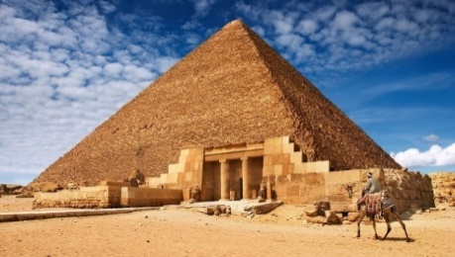
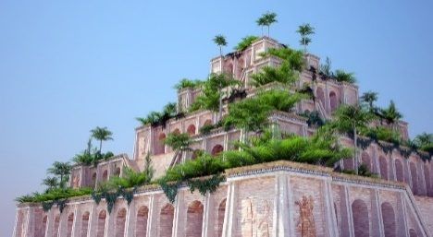
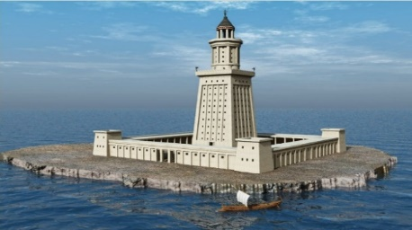
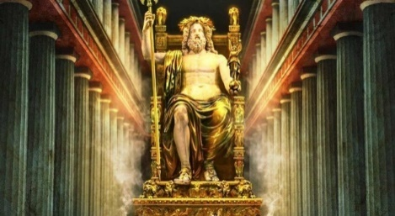


What were the classic seven wonders of the ancient world?
19
a) Colossus of Rhodes
b) Great Pyramid of Giza
c) Hanging Gardens of Babylon
d) Colosseum
e) Lighthouse of Alexandria
f) Mausoleum at Halicarnassus
g) Hagia Sophia
h) Statue of Zeus at Olympia
i) Porcelain Tower of Nanjing
j) Temple of Artemis at Ephesus
k) Stonehenge
?
?
?
?
?
?
?

Slide 23







What are New7Wonders of the world?
20
a) Great Wall of China
b) Petra
c) Red Square
d) Colosseum
e) Moai
f) Chichen Itza
g) Machu Picchu
h) Timbuktu
i) Taj Mahal
j) Christ the Redeemer
k) Alhambra
?
?
?
?
The Great Pyramid of Giza, largest and oldest of the three pyramids at the Giza Necropolis in Egypt and the only surviving (and oldest) of the original Seven Wonders of the Ancient World, was granted honorary status.
?
?
?

Slide 24



