Slide 1
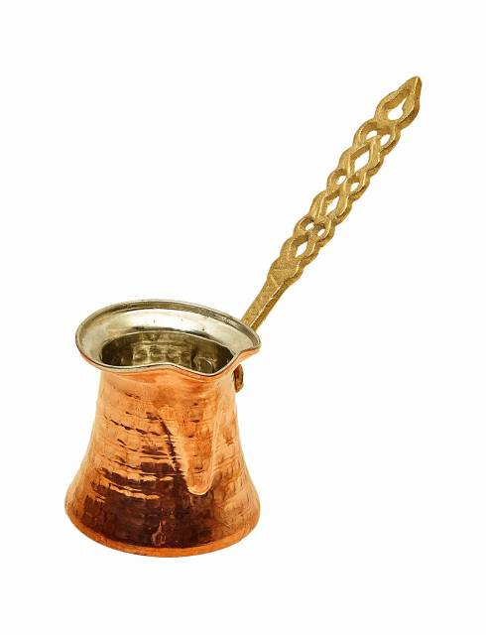

Tongue twister
Would you like a cup of coffee from a copper coffee pot?

Slide 2
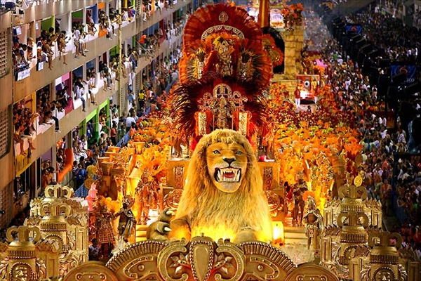
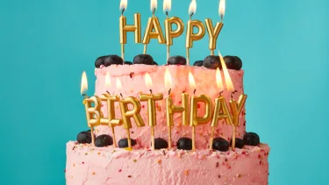
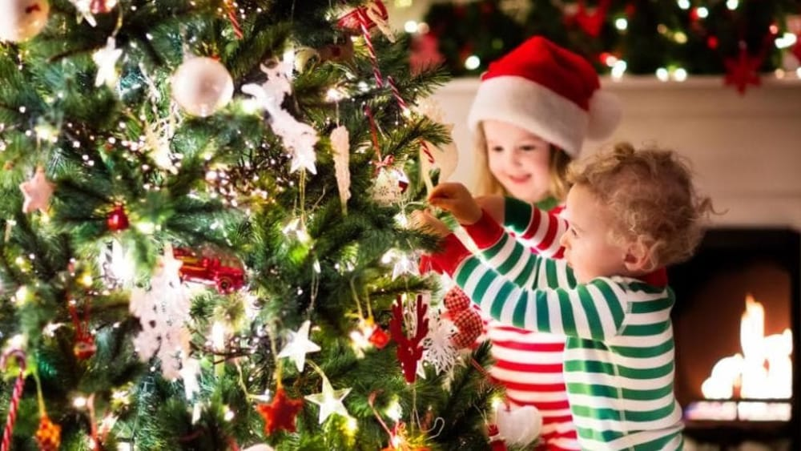
Special occasions
Vocabulary and Speaking
Carnival
Birthday
Our objectives for today are:
Revise vocabulary and use it in our speech
Christmas

Slide 3
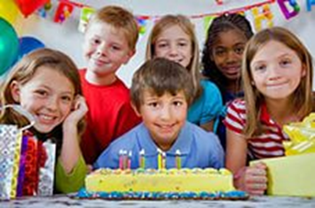
Words to remember
Blow out the candles – задувать свечи
Receive gifts – получать подарки
Exchange gifts / cards – обмениваться подарками / открытками
Throw streamers – бросать серпантин
Pull crackers – тянуть крекер (Рождественский обычай)
Dress up – наряжаться

Slide 4

The way we feel
excited
nervous
thrilled
enthusiastic
surprised
impatient
very happy because something good is going to happen
feeling anxious or slightly afraid
very interested in something or excited by it
wanting something to happen as soon as possible
the way you feel when something unexpected happens
very pleased and excited

Slide 5
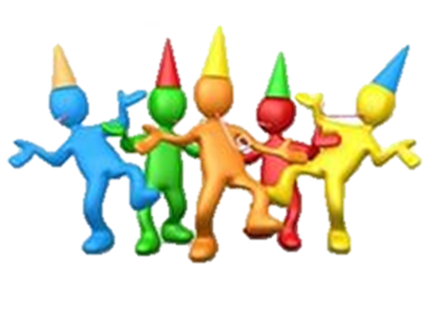
How do you feel when you celebrate any occasion?
Excited, exhausted, thrilled, enthusiastic, surprised, impatient, nervous
Example:
I am always excited at Christmas.
I feel impatient to open the presents.

Slide 6
Match the synonyms
thrilled
anxious
fascinating
reception
special
major
wish
choose
informal
worried
formal party
excited
interesting
want
casual
main
select
particular

Slide 7

Match the idioms with their translation.
Sell like hot cakes
The icing on the cake
Be a piece of cake
Have your cake and eat it
Простой, лёгкий
Пытаться совместить несовместимое
Идти на ура
Самый лучший

Slide 8
Homework
Выберите 1 из картинок (слайды 9, 10, 11). Опишите ее по плану (The place, The action, The appearance of the person, Whether you like the picture or not, Why) и отправьте голосовым сообщением своему учителю.
Мухаметшина Айгуль Фаритовна, aygul197422@mail.ru , 89083348748
Гамбарова Лилия Талгатовна, sal_gamb17@mail.ru , 89050381115
Романова Марина Анатольевна, 14marina11@mail.ru , 89274455104

Slide 9
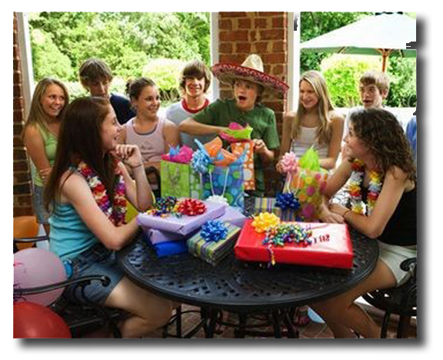
Picture 1

Slide 10
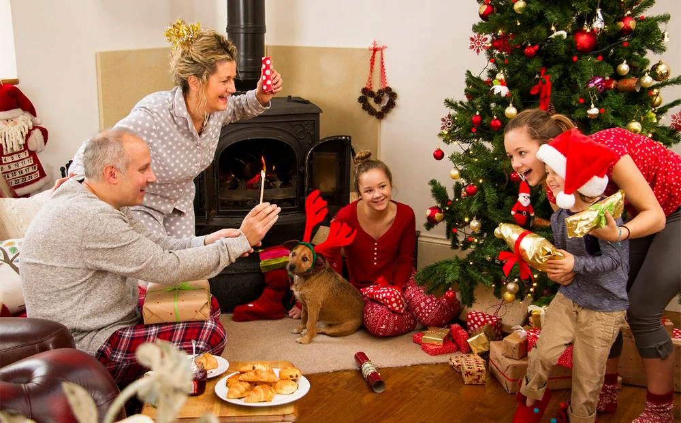
Picture 2

Slide 11
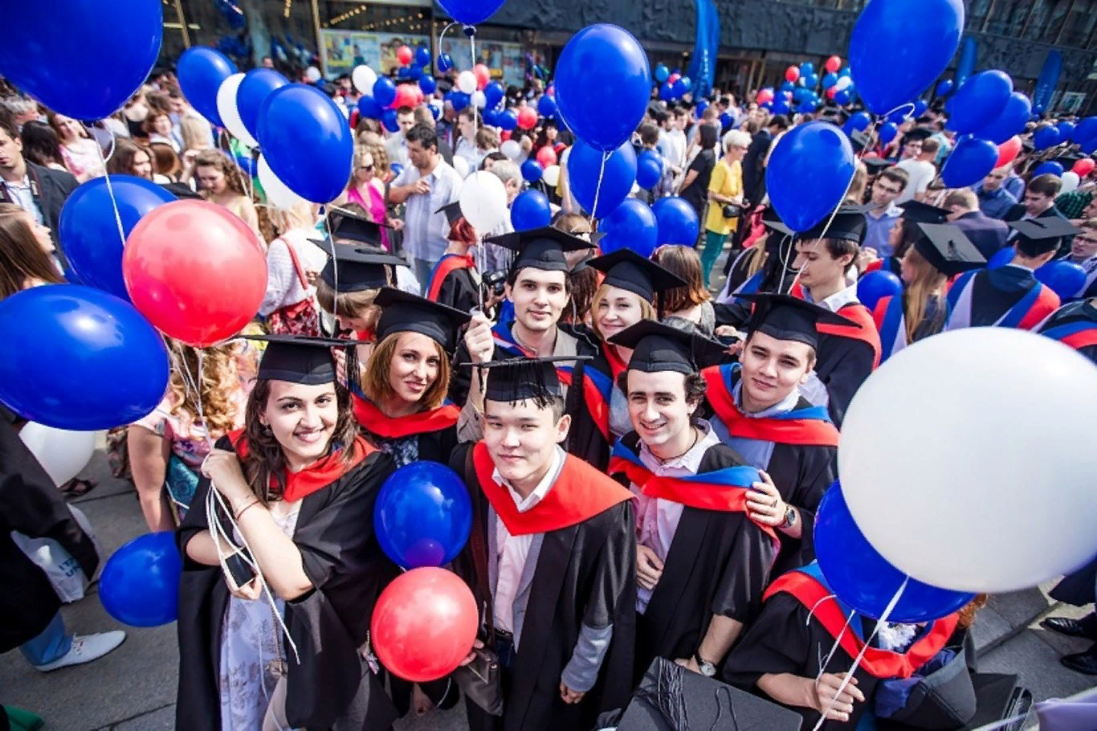
Picture 3

