Slide 1
Module 8
Challenges
Lesson 8f
Words often confused
English in Use

Slide 2

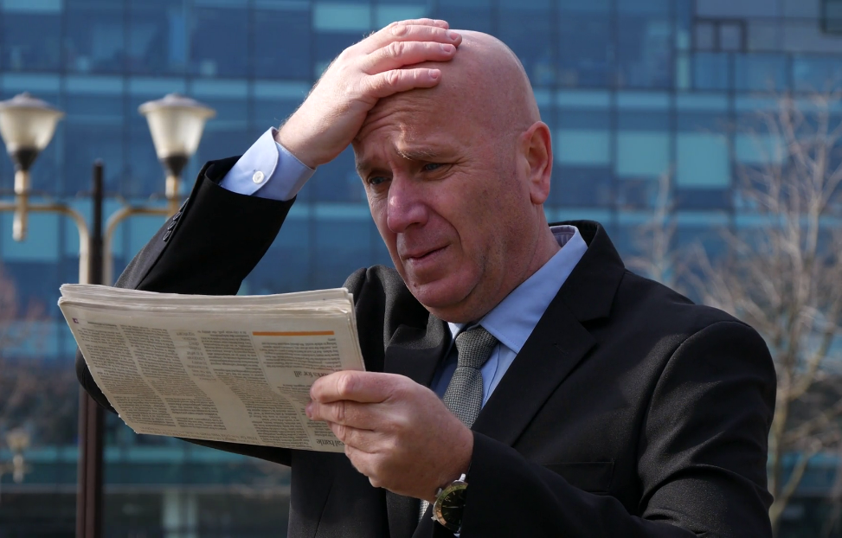
injure
harm
травмировать, повредить
нанести вред
to hurt or cause physical harm to a person or animal
to hurt someone or damage something
The article has harmed his reputation.
Thankfully no one was harmed in the accident.
I fell down the stairs and injured my leg.

Slide 3

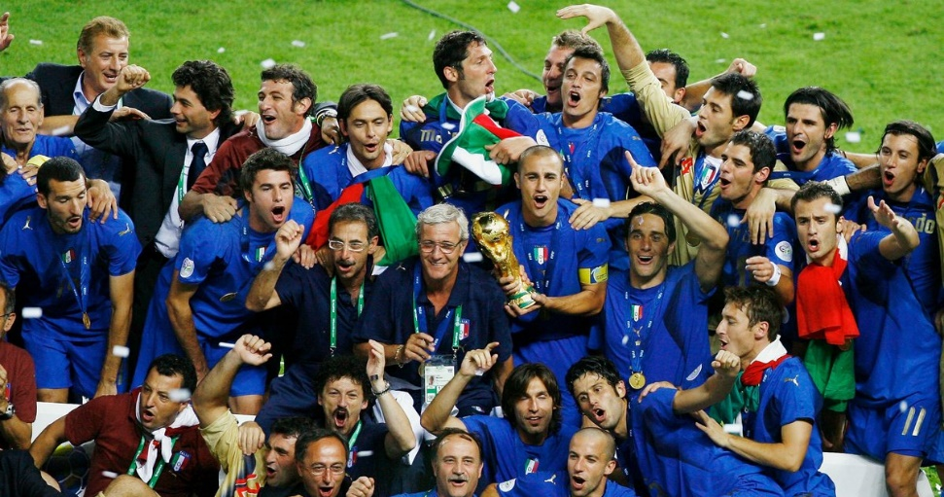
gain
win
приобретать, извлекать пользу
выиграть, заслужить
to get something that is useful, that gives you an advantage, or that is in some way positive, especially over a period of time
to achieve first position and/or get a prize in a competition, election, fight, etc
You can't gain access to the computer system without entering your password.
After you've gained some experience teaching abroad, you can come home and get a job.
Which year was it that Italy won the World Cup?
He would do anything to win her love.

Slide 4


suitably
соответствующим образом
properly
правильно
in a way that is acceptable and right for something or someone
in a way that is considered to be correct; correctly
There are rules about dressing suitably.
She was afraid she might not have behaved suitably.
To learn to speak a language properly, you have to live in the country where that language is spoken.

Slide 5
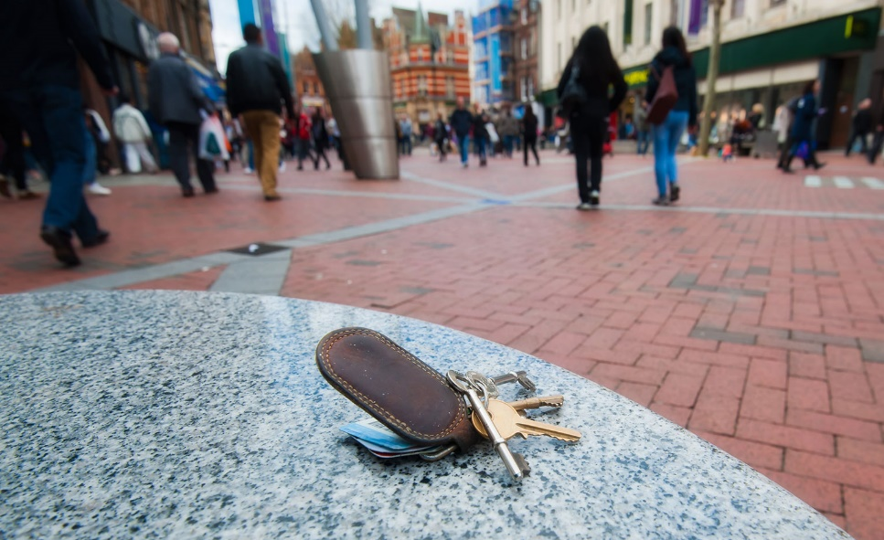

lose
miss
потерять
пропустить
to no longer have something because you do not know where it is
to fail to do or experience something, often something planned or expected, or to avoid doing or experiencing something
I missed the start of the class because my bus was late.
My office is first on the right with a bright red door. You can't miss it.
He's always losing his car keys.
I'm trying to lose weight.

Slide 6


recover
поправляться
resque
спасать, освобождать
to become completely well or normal again after an illness or having problems
to help someone or something out of a dangerous, harmful, or unpleasant situation
It took her a long time to recover from/after her heart operation.
They shouted for help, but nobody came to rescue them.

Slide 7


avoid
избегать, уклоняться
prevent
предотвращать, препятствовать
to stay away from someone or something
to stop something from happening or someone from doing something
I try to avoid supermarkets on Saturdays – they're always so busy.
If you want to lose weight, avoid eating between meals.
Label your suitcases to prevent confusion.
Nothing will prevent us from reaching our aim!

Slide 8


instead of
вместо, взамен
besides
кроме того, помимо, также
in place of someone or something
in addition to; also
You waste a lot of water by having a bath instead of a shower.
You can go instead of me, if you want.
Do you play any other sports besides golf?
She wants to learn other languages besides English and French.

Slide 9


inspire
promise
вдохновлять, внушать
обещать
to fill someone with confidence and desire to do something
to tell someone that you will certainly do something
He inspired many young people to take up the sport.
But listen, you must promise never to tell anyone!

Slide 10

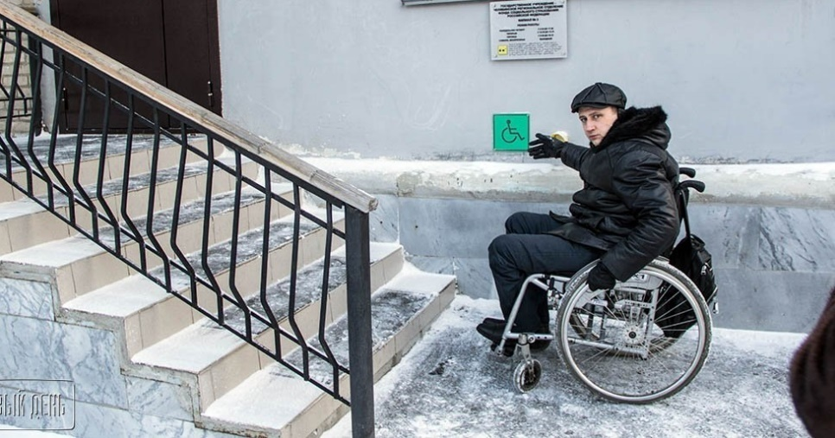
disability
inability
инвалидность, нетрудоспособность
неумение
an illness, injury, or condition that makes it difficult for someone to do the things that other people do
lack of ability to do something
Most public places are simply not geared to the needs of people with disabilities.
Inability to use a computer is a serious disadvantage when you are applying for jobs.

Slide 11


Slide 12
Homework
Составьте с 2 парами слов предложения и отправьте своему учителю
Мухаметшина Айгуль Фаритовна, aygul197422@mail.ru , 89083348748
Гамбарова Лилия Талгатовна, sal_gamb17@mail.ru , 89050381115
Романова Марина Анатольевна, 14marina11@mail.ru , 89274455104

