Slide 1
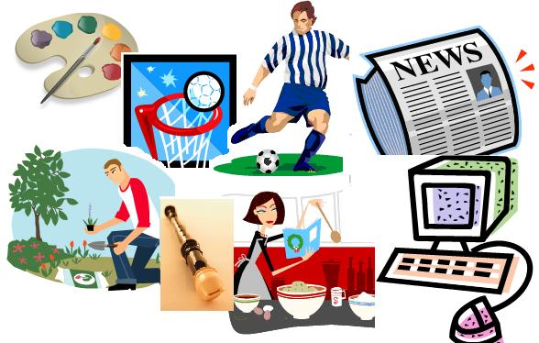

Повторение лексико-грамматического материала за курс 10 класса

Slide 2

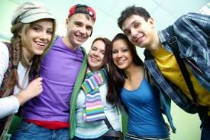
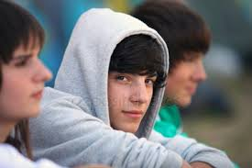
WHAT DO THESE LETTERS STAND FOR?
Suggest your ideas

Slide 3
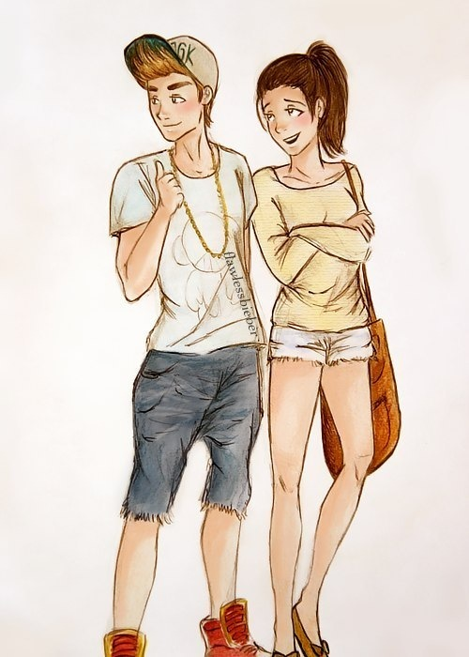
WHAT ARE TEENS MADE OF ?
T
E
E
N
A
G
E
R
S
tattoos, TV, training, tricks energy,
English songs,
easy-going
notebook
activities, achievements
going out
entertainments, e-chatting
rap music
singing songs, shopping

Slide 4
TEEN ACTIVITIES
Surf the Net
Chat online
Listen to music
Play computer games
Send emails
Go clubbing
Hang out with friends
Go window shopping
Watch TV
Do extreme sports
Spend time with family
Send text messages
Go on trips to the countryside
Do voluntary work (plant trees, run errands for the elderly)

Slide 5

LIKES/DISLIKES
I like it/I love it
It’s cool/great/ brilliant
I’m crazy about it
I’m really into it
I find it relaxing/
enjoyable
I like/love…
I hate it
It’s terrible
I don’t enjoy it very much
I don’t like it at all
I hate/can’t stand it
I don’t fancy it
It’s awful/boring

Slide 6
VOCABULARY
To be into smth. увлекаться
Bargain удачная покупка
Catch a film посмотреть фильм
Pastime времяпрепровождение
Check out проверить
Grab a bite перекусить
A waste of time пустая трата времени

Slide 7
HOMEWORK
Complete the gaps. One is extra
chat, grab a bite, fancy, watch, hanging out,
send, check out, catch
Let’s stop and … on the way home.
Teens enjoy… in the shopping malls.
Shall we … a film tonight? New Batman is on.
Me and Kate often … the shops for great bargains.
We mostly … with friends. It’s not common to .. messages any more.
I don’t … living in the countryside. I miss hustle and bustle of big cities.

