Slide 1



Повторение по теме: «Повседневная жизнь». Повторение по теме: «Здоровье и забота о нем»

Slide 2
Сlasswork. (Module-3, p.46-47)
Match parts of sentences.Check yourself.
A robber is someone who
A shoplifter is someone who
A witness is someone who
A murderer is someone who
A burglar is someone who
Takes things from shops without paying
Steals from people
Kills another person
Sees a crime
Enters a house and steals things

Slide 3





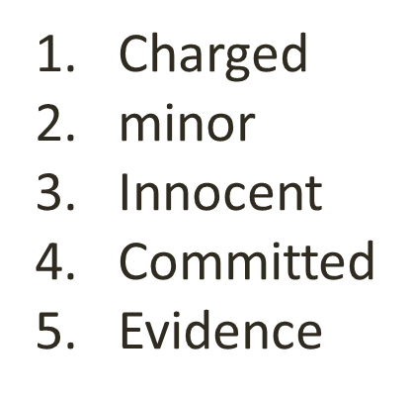
Committed, innocent, charged, evidence, minor
The police__________ him with murder.
He was fined because it was only a _______offence.
He said he was __________even when he went to prison.
I knew he had____________the crime because I saw him do it.
The police couldn’t charge me because they had no________________.

Slide 4
Put the verbs in brackets into the correct form(-ing form, to -infinitive or infinitive without to).(р.GR 6-7)
1. I am looking forward to… (watch) the Olympics on TV.
2. Remember…(buy) me a newspaper on your way home.
3. Please try…(be) on time.
4. She doesn't mind…(work) late.
5. Could you stop… (buy) some drinks for the party on your way home?
6. Do you mind…(wait) outside, please?
7. It's worth… (pay) a little more money to get a good seat.
8. Jane can… (snowboard) quite well.

Slide 5
Classwork.Module 4.Passive and Causative.
( р.GR 8-9) Choose the correct words to complete the sentences.
1.The treasure buried / had been buried in a box under a tree.
2.It found / was found by a small dog called Rex.
3.People tricked / are being tricked into believing that they can
get rich quickly.
4.Police say that a prisoner has escaped / is escaped from the local prison.
5.The map showed / was showing the exact location of the treasure.
6.Police heard / were hearing a phone conversation between two of the
robbers.
7.Two men arrested / were arrested yesterday as they tried to rob a local
bank.
8.People advised / are advised to be careful as there are two conmen
operating in the area.
9.Mary Smith found / was found some Roman coins in her back garden.

Slide 6
Check yourself
1 had been buried
2 was found
3 are being tricked
4 has escaped
5 showed
6 heard
7 were arrested
8 are advised
9 found

Slide 7
NYLON
The first man-made fibre NYLON 1_____(invent) in the early 1930s by an American chemist, Julian Hill. Other scien¬tists 2___(work) with his invention and finally on 27 October 1938, Nylon 3 ____(introduce) to the world. It was cheap and strong and immediately 4___ (become) successful, especially in the making of ladies' stockings.
During the Second World War, the best present for many women was a pair of nylon stockings, but more importantly, it 5 ____ (use) to make parachutes and tyres.
Today, nylon 6 (find) in many things: carpets, ropes, seat belts, furniture, computers, and even spare parts for the human body. It 7_____ (play) an important part in our lives for over 70 years. Next year about 36 million tons of it 8____ (manufacture).

Slide 8
NYLON. Check yourself.
was invented
worked
was introduced
became
was used
is found
has been playing
will be manufactured

Slide 9
Повторить слова модуля 4 стр.66. Пройти по ссылке : https://quizlet.com/270683080/spotlight-11-module-4-danger-unit-4b-illnesses-flash-cards/

Slide 10
Homework:
1.Выполнить задание со слайда 4 и отправить учителю.
Электронные адреса учителей:
Ганиева Лейсан Фердинантовна:
a_ljaisan@mail.ru (89600582820)
Романова Марина Анатольевна :
14marina11@mail.ru (89274455104)

