Slide 1
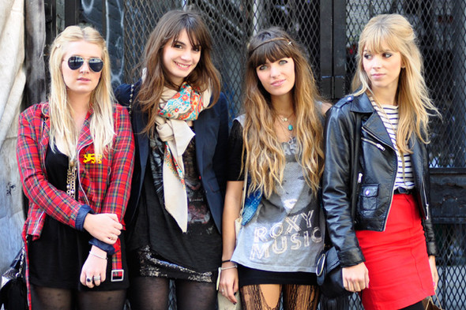
Teenage Fashion
Повторение лексико-грамматического материала за курс 10 класса

Slide 2
Translate these phrases into Russian
Picking up bargains
Affordable
The other way round
Second-hand shops
Individuality
Keeping up with all latest trends
Top designers
Rip smth.

Slide 3
Translate these phrases into Russian
Take smb. Inspiration
Hit the shops
Reasonably well-dressed
Bothered about
Tend to stick to cheaper clothes
Stand out in a crowd
Influenced by
Multi-cultural

Slide 4
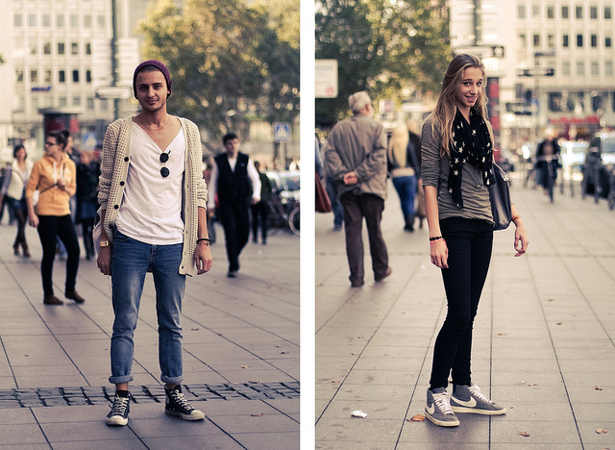
Describe what kind of clothes do these teens like wearing using new phrases

Slide 5
Homework
What do you like wearing?
Образец(используем новую лексику!)
It goes without saying I like trendy clothes! But as for me I don’t keep up with the trendy brands as the are not affordable for me. So I tend to stick to comfortable clothes that show a little bit of individuality. I love feeling free during the day and I am not really bothered about brand names and logos. Sometimes I hit the shops in a high street, picking up some great bargains or popping in the second-hand shops as I like to stand out in a crowd!

