Slide 1
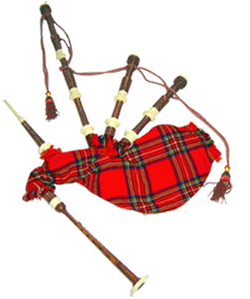
Tour beautiful Scotland by coach.

Slide 2

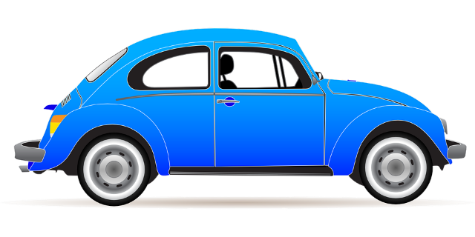

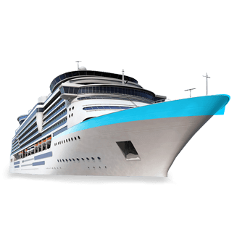
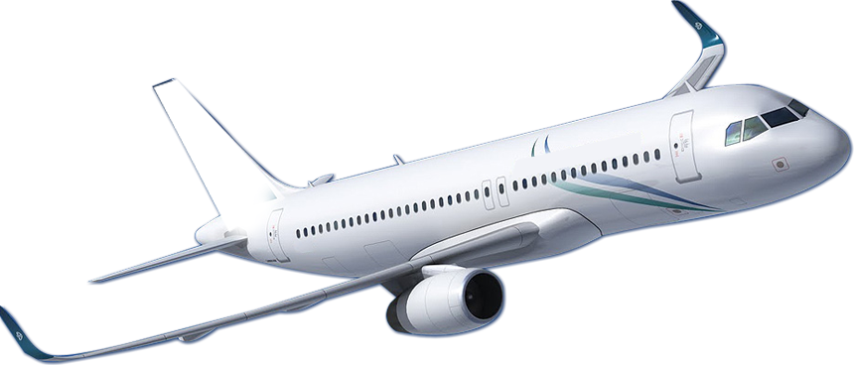
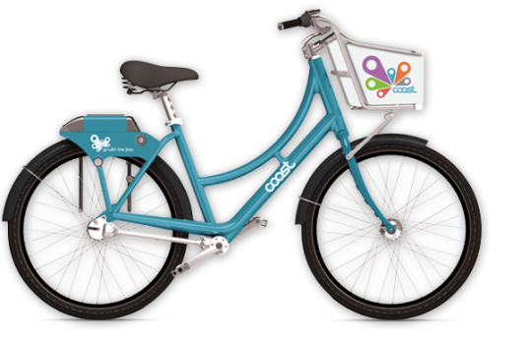
Let’s Travel
by bus/coach
by car
by train
by ship
by bike
by plain

Slide 3
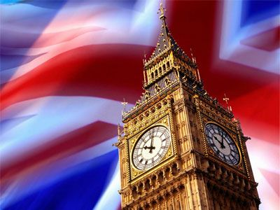

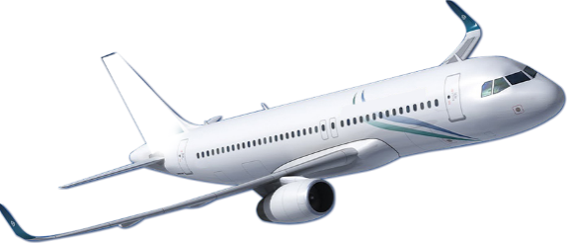
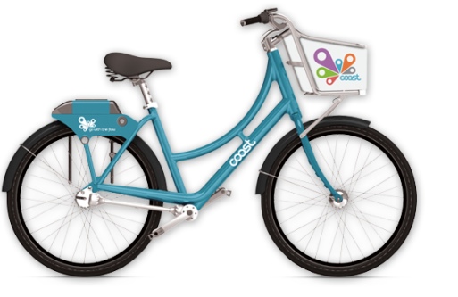
Let’s visit Great Britain!
We can get there by
We can’t get there by

Slide 4
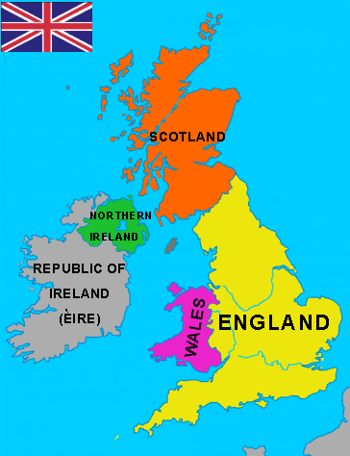
Great Britain consists of 4 parts:
England, Scotland, Wales and Northern Ireland.
*consist of – состоит из

Slide 5
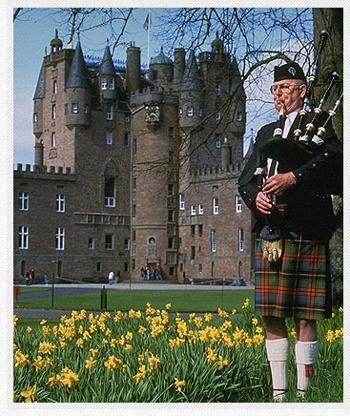
We will visit Scotland!
We’ll take a coach-tour!
a coach-tour автобусный тур

Slide 6
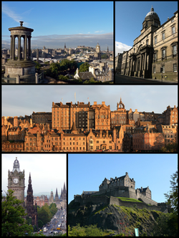
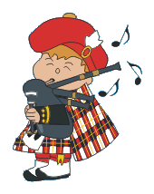
Welcome to the capital of Scotland – Edinburgh!
* capital - столица

Slide 7
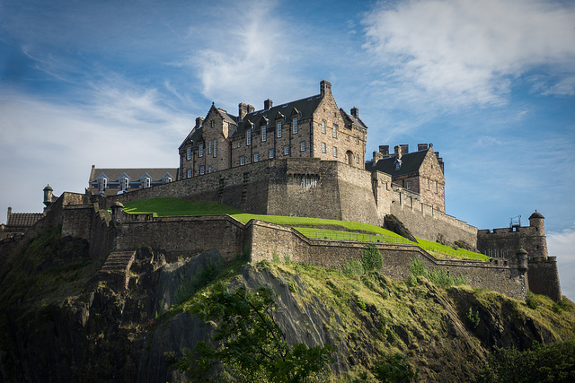

It is famous for its castle.
*famous for – известен чем-либо
*castle - замок

Slide 8
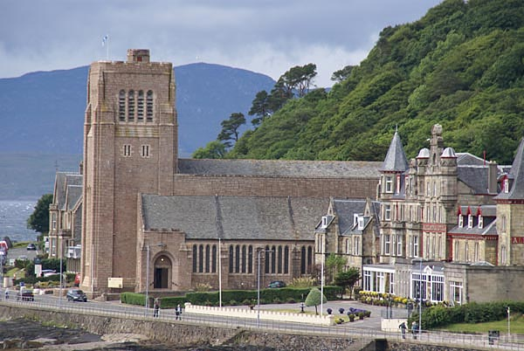
Oban is a big port, famous for its beautiful cathedral.
*cathedral - собор

Slide 9
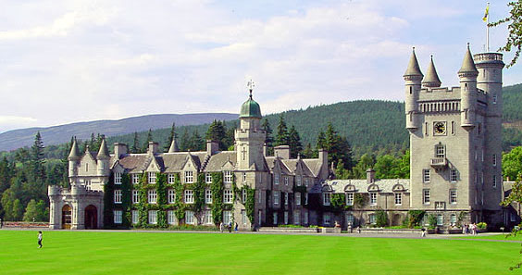
Balmoral is a castle in Ballater.

Slide 10

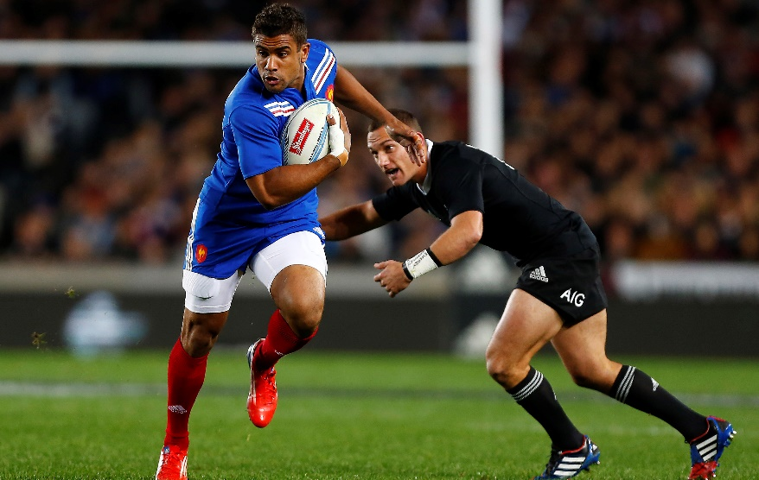
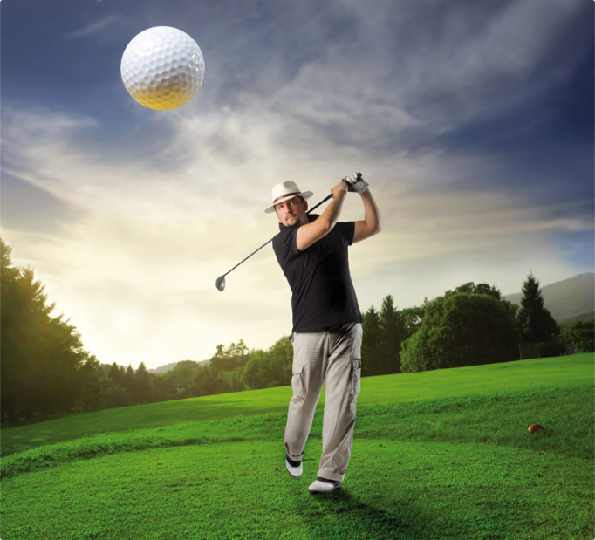
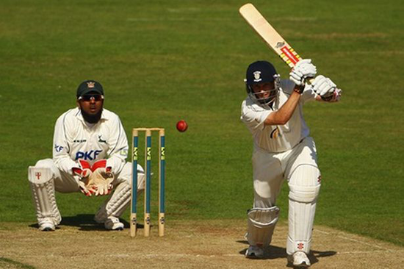
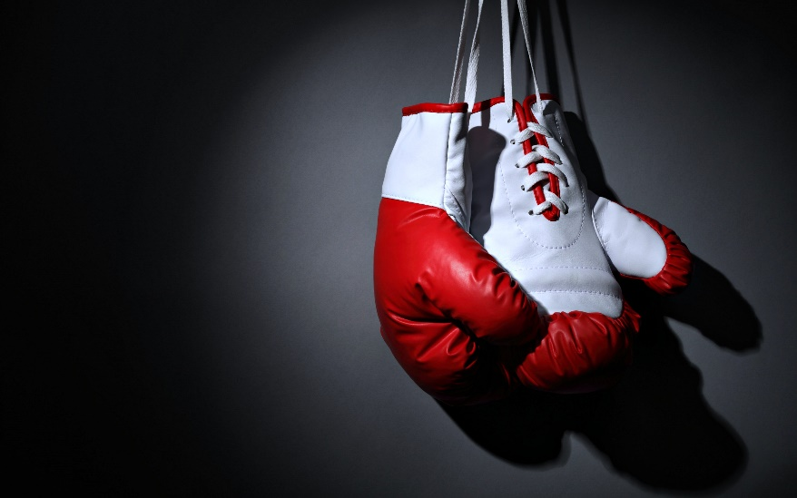
Sports

Slide 11
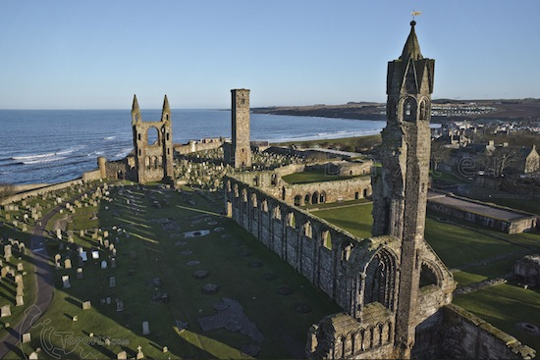

If you want to play golf – go to
St. Adrew’s!
St. Andrew’s

Slide 12
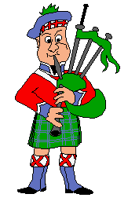
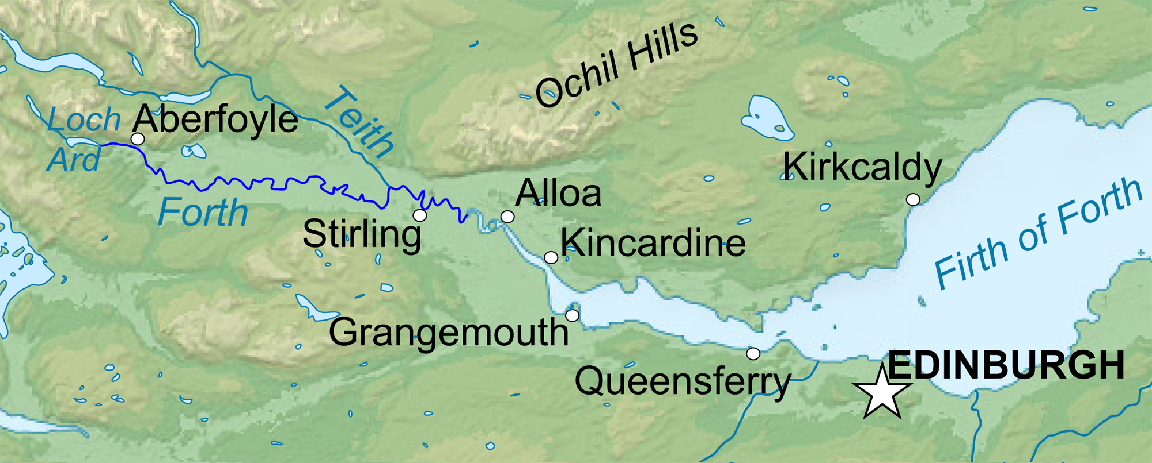
If you want to swim in the river Forth – go to Stirling!

Slide 13
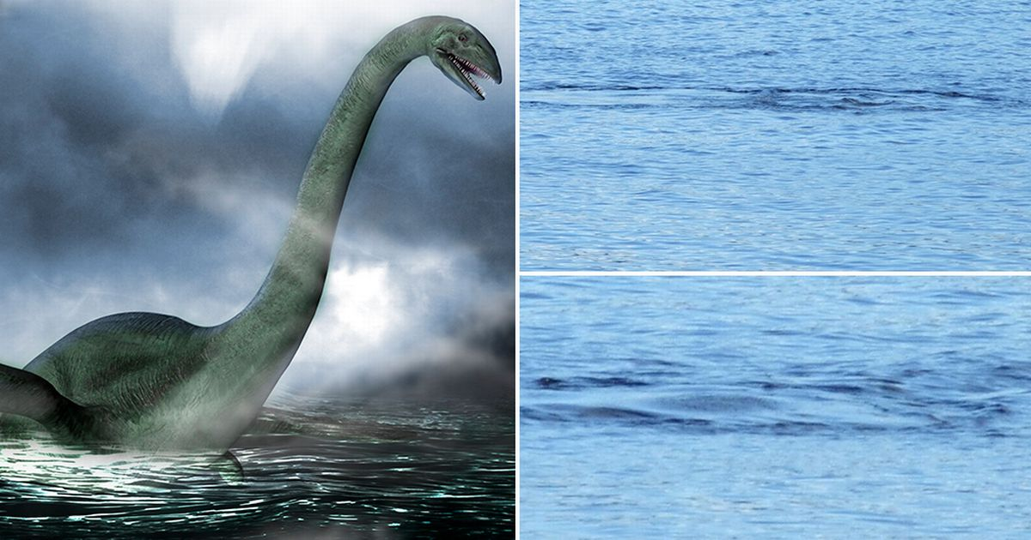
Loch Ness Lake is famous for the legend about the underwater monster called Nessie.
*underwater - подводный

Slide 14
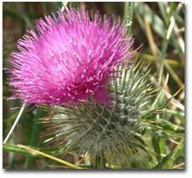
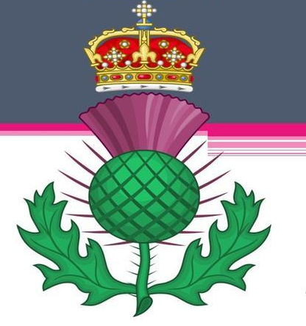
The thistle is the symbol of Scotland.
*thistle - чертополох

Slide 15
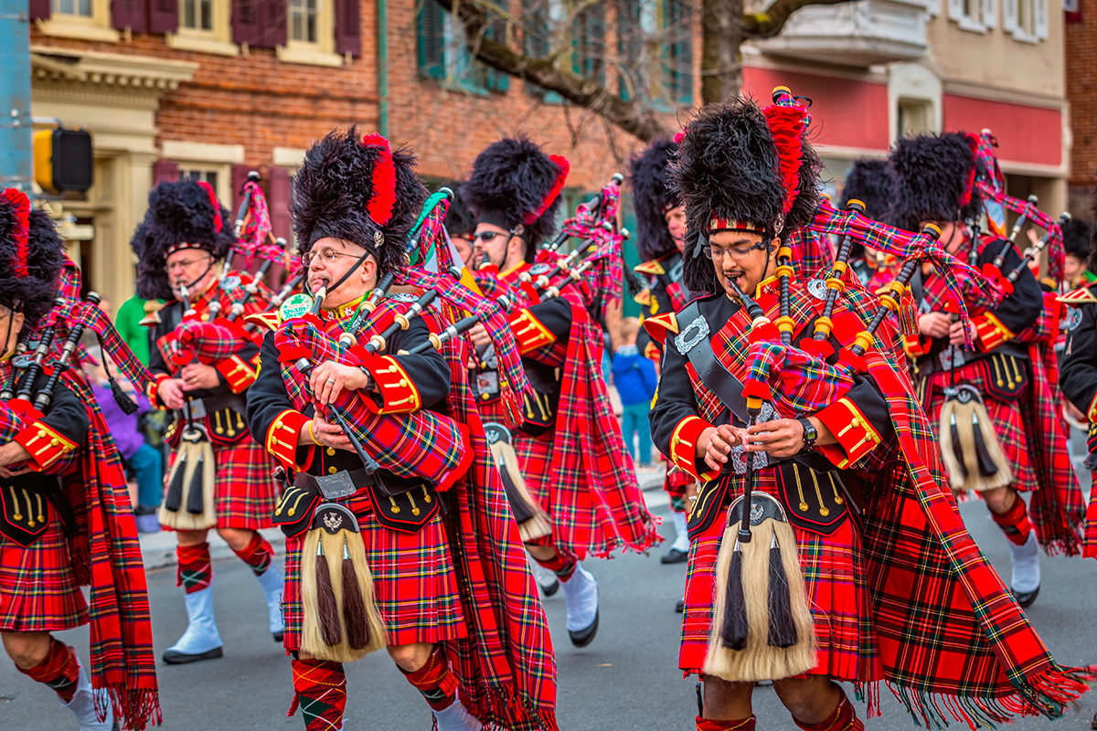
Bagpipe (волынка) – is a national instrument of Scotland.

Slide 16
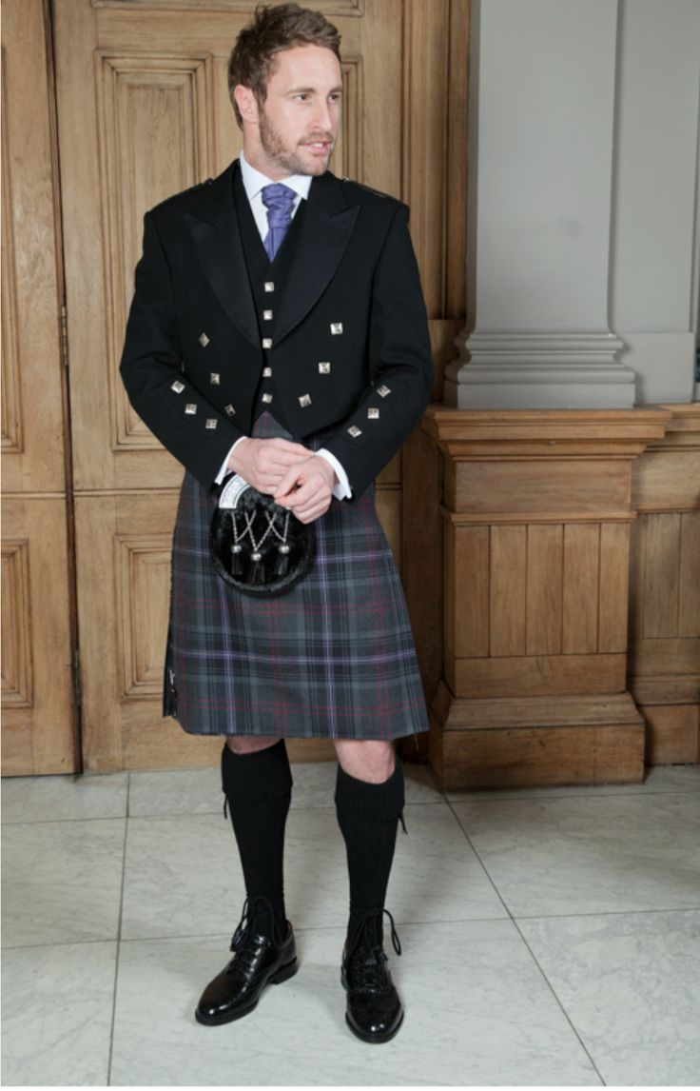
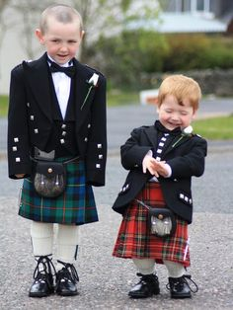
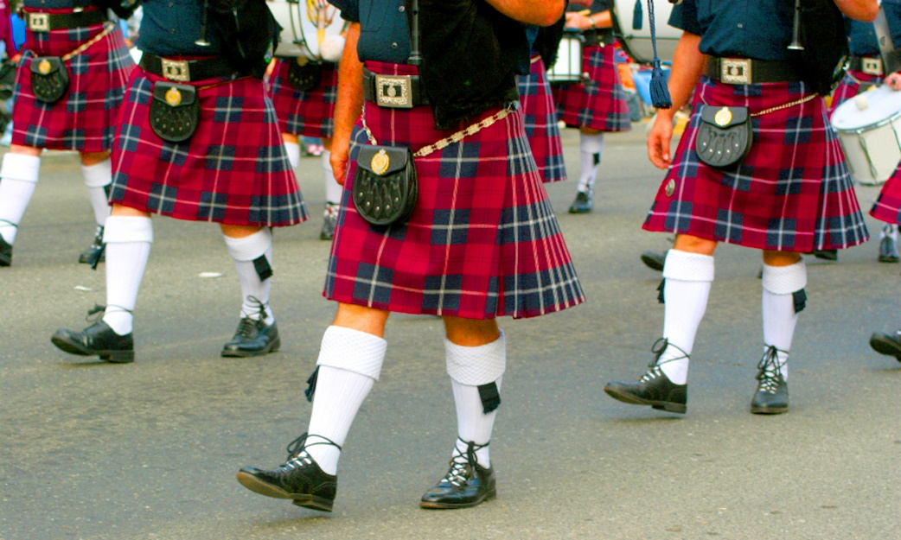
Another symbol is kilt – a traditional men’s skirt.

Slide 17

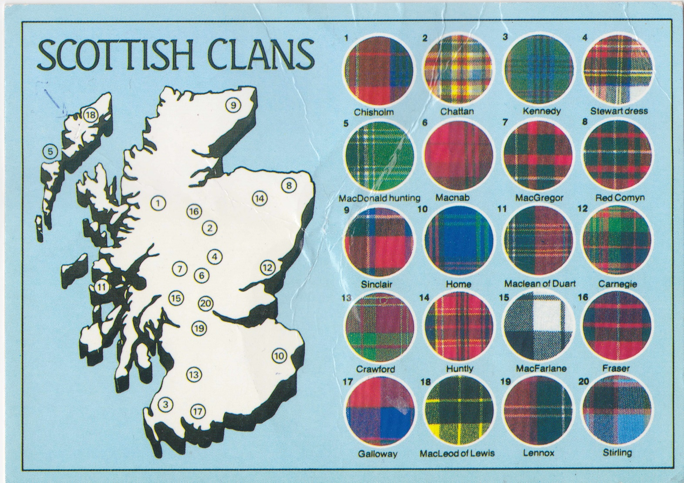
tartan- шерстяная клетчатая материя
Every clan has its own tartan.

Slide 18

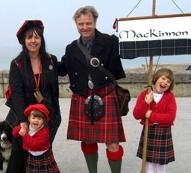

Scotland is a beautiful country with long history and interesting traditions. Come to see us again!

Slide 19
Homework
Изучите презентацию, ответьте на вопросы:
What is the capital of Scotland?
What rivers, lakes in Scotland do you know?
What is the main musical instrument in Scotland?

Slide 20
Адреса учителей
ФИО учителя | Адрес электронной почты | Номер телефона (Whatsapp)
Шаймарданова Гульшат Ришатовна | espanol1606@mail.ru | 89179372042
Мустафина Гульнира Наилевна | mustafina_nira@mail.ru | 89656091266
Гамбарова Лилия Талгатовна | sal_gamb17@mail.ru | 89050381115
Резванова Лариса Хамисовна | kler_dima@mail.ru | 89120949396
Мухаметшина Айгуль Фаритовна | aygul197422@mail.ru | 89083348748

